Slide 1
FOUR SQUARE DISCUSSION

Slide 3
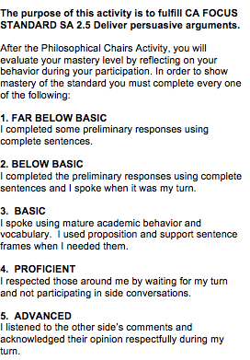
Before we begin: Circle your Mastery Target

Slide 9
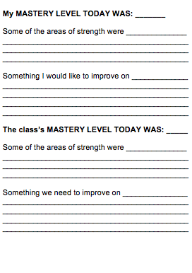
After Discussion: Identify the Mastery Level Accomplished

Slide 10
Whip Around
I liked when _______ said __________ because _______________.
An interesting idea _______________
Something I learned from the discussion ______________________.
I still don’t understand _____________.
Notes:
10

