Slide 1
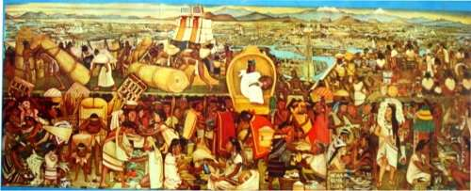
Native Voices
After annotating passages from creation stories of the Americas, students will be able to identify native views of “human nature” completing summaries that include events used to develop moral lesson in the story.

Slide 2
Reflection
What is the role that “ nature” plays in the central conflict of Arthur Miller’s The Crucible? What does this reveal about Puritan attitudes toward “nature”? Explain using specific examples from the play.

Slide 3
First read…
Number the Paragraphs.
Look at the title and use your background knowledge to predict what author will be arguing in this essay.
Quick-Read: 3 minutes
Skim through the article and circle KEY words that seem to be important to what he will be arguing or communicating.

Slide 4
Second: ANNOTATE
Teacher reads TWO PARAGRAPHS AT A TIME. Leaves one minute for student to do the following:
Underline sentences that help you understand the author’s argument and purpose. Use the following questions to guide your annotations.
What is the author’s argument? Purpose?
How evidence does the author use to support his argument and accomplish his purpose?
What is the author’s tone? What word choices does he make to communicate the appropriate tone?
Do you agree with him? Why or why not?

Slide 5
After your 2nd read…
What is the author’s purpose in writing this essay? In other words, what is he trying to accomplish?
What is his central claim or argument?
Simple:
The article argues that ____________ is bad/good _______because______.
Sufficient:
According to ______, ____________.
Sophisticated:
In the article, “________,” _____ asserts/ proposes/ claims _______________.

Slide 6
Third read: MARGINALIA
SECOND READ: Explain your annotations:
* Identify and Summarize Main Ideas and arguments: i.e. This explains that___.
✔ Evidence used to support argument:
i.e. This demonstrates/ illustrates/conveys.
? Clarify questions and confusion:
i.e. I don’t understand ____. What does ___ mean? I wonder why____.

Slide 7
Background Paragraph
TOPIC SENTENCE: What is the central claim of Joseph Bruchac’s essay, “The Sun Still Rises in the Same Sky”?
INTRODUCTION TO EVIDENCE: What is the purpose of his essay?
EVIDENCE: What examples/ evidence does he provide to support his central claim?
ANALYZE: What do his examples/ evidence reveal/ prove/ illustrate?
COMMENTARY: What does Bruchac’s essay contribute to your understanding of American literature?

