Slide 1
Introduction to Mexican American identity
UNIT GOAL: Define central terms and evaluate basic issues and themes.

Slide 2
Today’s Objective
After participating in IDENTITY CORNERS, students will be able to
use academic behaviors and practice discourse of scholarship to gain an understanding of the various social identities in which people associate themselves with and the importance of each one.
Listen to different perspectives of the participants involving these social identities.
Apply key terms which will be used in class and evaluate the importance of each to the study of cultural identity.

Slide 3
AGENDA:
First, I will introduce the definition of IDENITY through GIVE ONE GET ONE activity.
Then, we will participate in IDENITY CORNERS EXERCISE.
Finally, you will reflect and evaluate the discussion.

Slide 4
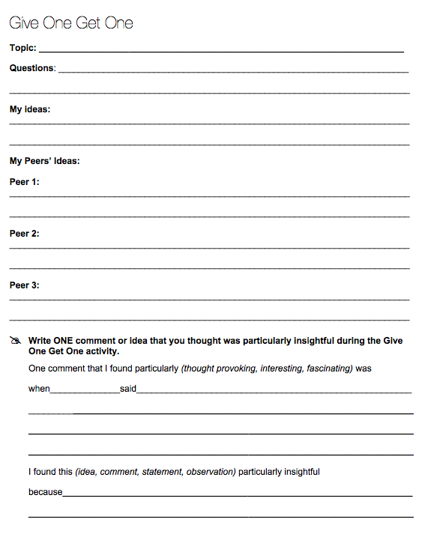
Identity: the fact of being who or what a person or thing is.
When someone asks, “What are you?” referring to a racial group or ethnicity, how do you answer? Why?
Part 1: Write out your ideas on topic. (2 minutes)
Part 2: Talk to your classmates about their ideas on the topic. It may not be anyone from your pod. (5 minutes)
Part 3: Reflect on your conversations and comment on one idea that you thought was MOST insightful. (5 minutes)

Slide 5
IDENTITY CORNERS
THERE ARE social identity signs around the room.
Gender, Ethnicity/Race, Class (Socio-Economic Status), Religion, Ability Status, Citizenship Status, Age, Sexual Orientation
Clarify the meanings of each social identity for the participants.
Participants will first gather to middle of the room.
Teacher will read out 8 statements about identity.
Participating will move to the IDENTITY CORNER they most associate with regarding the statement that is read off.
After each statement is read, participants will discuss their choice with those in their corner.
GROUP will choose 1 or 2 participants to share why they chose that social identity with class.

Slide 6
Identity Corners

Slide 7
Which of your identities are you most conscious of in your everyday life?

Slide 8
When you are with your family which term best describes your identity?

Slide 9
When you are with your friends which term best describes your identity?

Slide 10
When fill out paperwork which term best describes your identity?

Slide 11
Which of your identities do you receive the most benefits from?

Slide 12
Which of your identities do you get the most disadvantages from?

Slide 13
Which of your identities has the least amount of influence in your life?

Slide 14
Which of your identities has the most stereotypes associated with it?

Slide 15
Which of your identities has the most stereotypes associated with it?

Slide 16
Which of your identities do you feel is most suppressed by society? Oppressed?

Slide 17
Which of your identities do you feel you are most at ease with/comfortable with?

Slide 18
Whip Around
I liked when _______ said __________ because _______________.
An interesting idea _______________
Something I learned from the discussion ______________________.
I still don’t understand _____________.
Notes:
18

