Slide 1
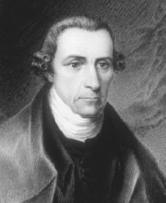
Speech to the Virginia Convention
By Patrick Henry

Slide 2
During Today’s Lesson
OBJECTIVE: By practicing CLOSE READING strategies, SWBAT analyze Patrick Henry’s, use of LOADED WORDS, PARALLEL SRUCTURE and rhetorical triangle in “Speech to the Virginia Convention” to justify American rebellion against the British and persuade fellow Americans to join the revolution and take up arms.
Evidence of your learning will be shown through:
Annotations and Marginalia
Says Means Matters and summary.
Progress Check

Slide 3
Reflection:
TOPIC SENTENCE: In the “Speech to the Virginia Convention,” Patrick Henry proclaims, “Give me liberty, or give me death.” Through this statement, he asserts his belief that liberty is a value worth sacrificing one’s life for. Do you agree?
INTRODUCTION TO EVIDENCE: Explain your opinion.
EXAMPLE: Explain your opinion with clear examples from your experience.
ANALYSIS: How do these examples support your opinion?
COMMENTARY: Who would this early American agree with Hobbes or Rousseau? Explain.

Slide 4
EARLY AMERICAN WRITING
Sermons
Autobiographies
Political Documents
Journals/Diaries

Slide 5
Use circle map info to write background paragraph.
Use the following paragraph frame:
_______can be described as ______. He was born
________ and spent most of his life________. While ________, he became interested in ________.
Additionally, ________________. His writing attempts to ______________ by _______________.
As you read the biographical article, fill in circle map with important information about Author’s background.
Patrick Henry
Notes:
Have students use circle map to write a paragraph on Jonathan Edwards.

Slide 6
PARALLELISM
A.K.A. Parallel Structure
The repetition of words, phrases, clauses, or sentences.
For example, in The Declaration of Independence Jefferson cites truths that are “self-evident,” he begins each clause with “that.” He also begins a long series of paragraphs with the words “He has.” Jefferson’s use of parallelism creates a stately rhythm or cadence. Listen for this as you read.

Slide 7
Rhetorical Question
A question that requires no answer.
It presumes that the audience agrees with the speaker on the obvious or logical answers.
LOADED WORDS: words charged with emotion

Slide 8
Tone: the attitude a writer takes toward the subject of a work
Objective (Informational) v. Subjective (Emotional)
Tone is dependent on diction (word choice) and style.
Style: The distinctive way in which a writer uses language. This includes sentence length, complexity, syntax, figurative language and word choice.
Formal v. Infomal

Slide 9
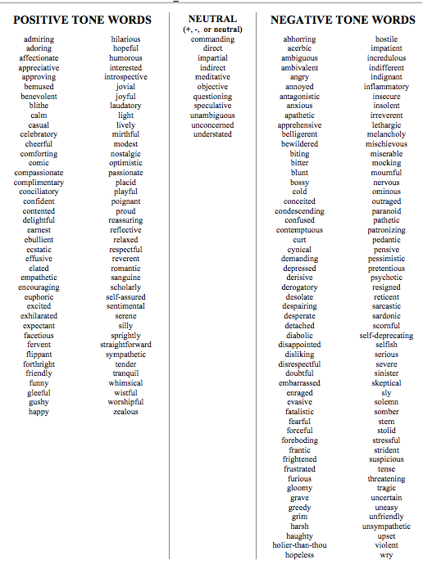
TONE TOOL:
Use this to help you identify specific tone of a text.
Step 1: Is it neutral, positive, or negative?
Step 2: Go through the list and find appropriate and specific word.
Let’s practice…

Slide 10
First read…
Number the Paragraphs.
Look at the title and use your background knowledge to predict what author will be arguing in this essay.
Quick-Read: 3 minutes
Skim through the article and circle LOADED words that convey tone and seem important to what he will be arguing or communicating.

Slide 11
Second: ANNOTATE
Teacher reads TWO PARAGRAPHS AT A TIME. Leaves one minute for student to do the following:
Underline sentences that help you understand the author’s argument and purpose. Use the following questions to guide your annotations.
What is the author’s argument? Purpose?
How does the author use IMAGERY & FIGURATIVE LANGUAGE to support his argument and accomplish his purpose?
What is the author’s tone? What word choices does he make to communicate the appropriate tone?

Slide 12
After 2nd read: MARGINALIA
SECOND READ: Explain your annotations:
* Identify and Summarize Main Ideas: i.e. This explains that___.
✔ Evidence used to support argument:
i.e. This demonstrates/ illustrates/conveys.
? Clarify questions and confusion:
i.e. I don’t understand ____. What does ___ mean? I wonder why____.

Slide 13
After your 2nd read…
What is the author’s purpose in writing this text? In other words, what is he trying to accomplish?
What is his central claim or argument?
Simple:
The text argues that ____________ _______because______.
Sufficient:
According to ______, ____________.
Sophisticated:
In the text , “________,” _____ asserts/ proposes/ claims _______________.

Slide 14
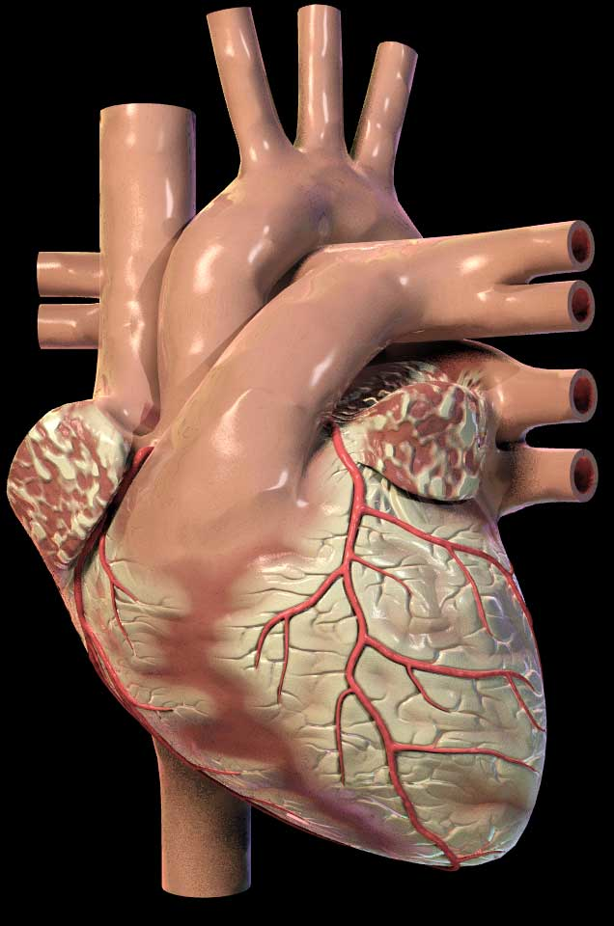
Rhetorical Devices or Persuasive Strategies
LOGICAL APPEALS
a.k.a. LOGOS
EMOTIONAL APPEALS
a.k.a. PATHOS
ETHICAL APPEALS
a.k.a. ETHOS
Using facts and logic to convince audience.
Using emotions to convince the audience.
Establish credibility and appeal to your readers’ ethics and/or moral values.
For example:
A snickers bar is 280 calories. 4 out 5 doctors agree that eating one daily is not very healthy.
For example:
Your donation will help this puppy find a safe loving home and have a chance at a bright future.
For example:
Believe me, I have been through your struggle and I know what it is like to be unemployed.

Slide 15
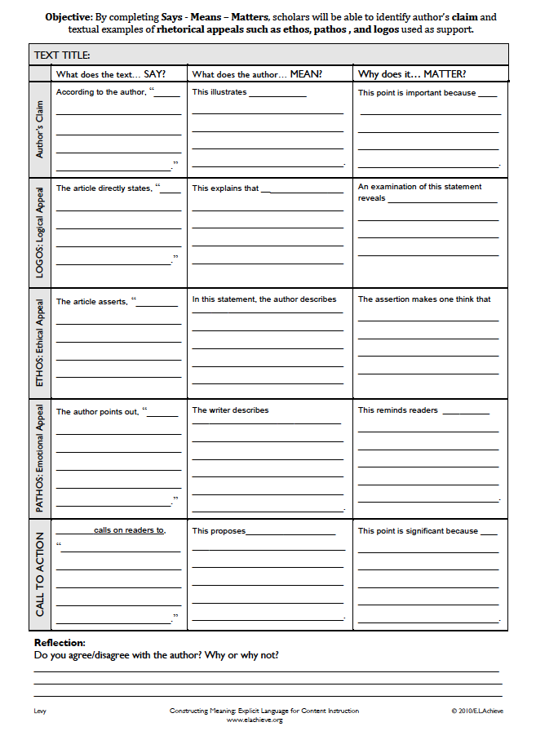
Says-Means-Matters to show that you can cite and analyze and comment on Thomas Jefferson’s use of the Rhetorical Triangle to persuade his audience to dissolve their relationship with Britain and join the revolution.

Slide 16
OBJECTIVE: By completing a SOAPS on The Declaration of Independence, The Iroquois Constitution and The Declaration of the Seneca Falls Woman’s Right’s Convention use of LOADED WORDS, PARALLEL SRUCTURE and rhetorical triangle to achieve purpose, and support central argument.

