Slide 1
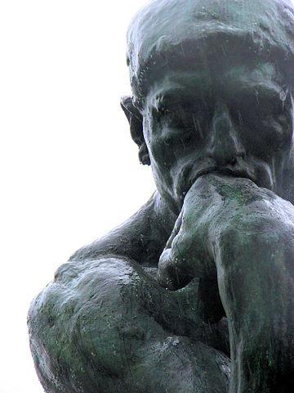
Encounters & Foundations: Post-Unit Philosophical Chairs

Slide 2
Today’s Objective
Unit Goal
In a TIMED WRITE ESSAY, SWBAT describe how Early American texts and genres explored and communicated views of human nature through the use of the rhetorical triangle, imagery, and figurative language.
By reflecting and discussing Early American values and philosophical ideas, students will be able to explain how these early writers’ views of human nature influenced American identity and political thought.

Slide 3
AGENDA:
First, I will introduce the statements for discussion and students will set Mastery Level Goals.
Then, we will participate in Philosophical Chairs.
Finally, you will reflect and evaluate the discussion.

Slide 4
Philosophical Chairs
Directions: Read the following statements and rate your level of agreement from AGREE TO DISAGREE.
Prepare to discuss you answer by writing a brief explanation of your opinion on the lines which follow.

Slide 5
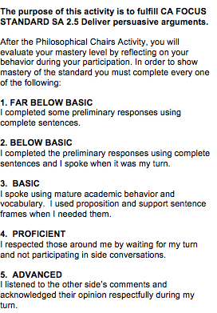
Before we begin: Circle your Mastery Target

Slide 6
Religion/church help us build better societies that are based on morals and values.

Slide 7
Only fear of an outside power keeps people on check.

Slide 8
Human nature is good, but corrupted by society and environment.

Slide 9
Although slavery was bad, its legacy no longer affects our country.

Slide 10
As promised by the Declaration of Independence, total equality has been achieved by our country.

Slide 11
Liberty is a value that we must hold higher than all others, in order to maintain the American Identity we are known for.

Slide 12
The government that governs least, governs best.

Slide 13
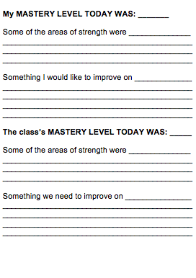
After Discussion: Identify the Mastery Level Accomplished

Slide 14
Whip Around
I liked when _______ said __________ because _______________.
An interesting idea _______________
Something I learned from the discussion ______________________.
I still don’t understand _____________.
Notes:
14

