Slide 1
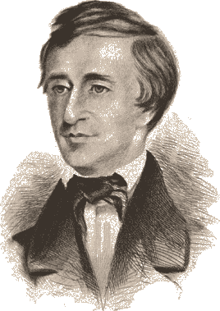
Thoreau Transcendentalism

Slide 2
Thoreau and the Politics of Transcendentalism
CA Focus Standard:
Objectives:
Define paradox.
Identify the main idea of Henry David Thoreau’s essays “Walden” and “Resistance to Civil Government” and explain how he uses paradox and figurative language as support.

Slide 3
After you watch preview video, use circle map info to write background paragraph.
Use the following paragraph frame:
_______can be described as ______. He was born
________ and spent most of his life________. While ________, he became interested in ________.
Additionally, ________________. His writing attempts to ______________ by _______________.
As you watch video, fill in circle map with important information about author’s background.
Author
Notes:
Have students use circle map to write a paragraph on Jonathan Edwards.

Slide 4
How does Thoreau fit into Transcendentalism?
After college, Thoreau befriended Emerson who introduced him to Transcendentalism
Since its publication in 1849, "Civil Disobedience" has inspired many leaders of protest movements around the world. This non-violent approach to political and social resistance has influenced American civil rights movement activist Martin Luther King Jr. and Mohandas Gandhi, who helped India win independence from Great Britain, among many others.
Thoreau coined the term “Civil Disobedience” when he chose to disobey a law he considered unjust

Slide 5
Key Beliefs of Transcendentalism
Natural Interconnectedness: People and nature are connected and reflect each other. “You know your individual nature through communion with nature.”
Individuality: Be true to YOURSELF! Individuals should not conform blindly to beliefs imposed on them by society. Trust your intuition over belief systems built to control you.
Spiritual self-reliance: Do not trust dogma or institutions. Nothing is more sacred than the integrity of our own individual mind. “You are sacred, because your spirit holds the divine within it. Religion or church cannot teach you about your spirit.”
Explain key beliefs of transcendentalism to your partner. (AC, BD)

Slide 6
Sentence Frames for identifying author’s main argument and purpose.
Simple:
The article argues that ____________.
Sufficient:
According to ______, ____________.
Sophisticated:
In the article, “________,” _____ asserts _______________.

Slide 7
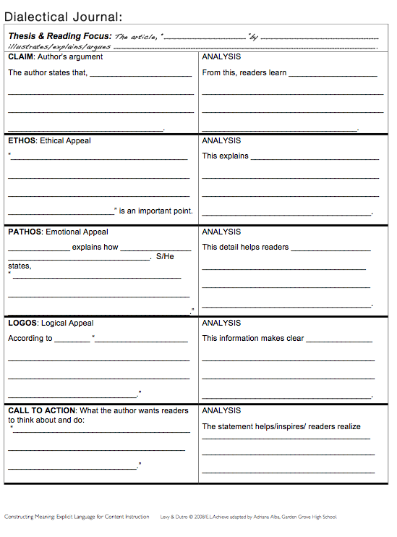
Dialectic Journal/Says-Means-Matters to cite and analyze text

Slide 8
Find a quote that expresses Key Beliefs of Transcendentalism
From Economy
From “Where I lived and What I lived for”
From “Solitude”
From “Bean Field”
From “Brute Neighbors”
From “Conclusion”

Slide 9
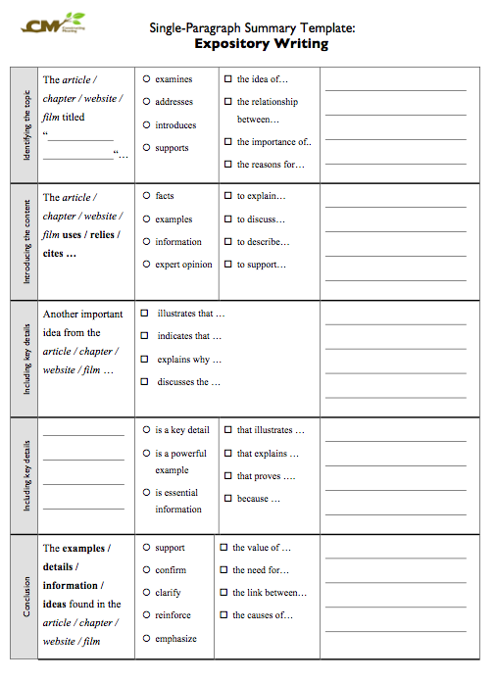
Summary Template to identify main idea and key details.

Slide 10
Objective
Objective: After reading Henry David Thoreau’s essay “Resistance to Civil Government,” students will analyze the use of figurative language and paradox to support his beliefs about government and nature.
Evidence of Learning:
Read and Complete a Cornell Notes on “Resistance to Civil Government” by Henry David Thoreau

Slide 11
After you watch preview video, use circle map info to write background paragraph.
Use the following paragraph frame:
_______can be described as ______. He was born
________ and spent most of his life________. While ________, he became interested in ________.
Additionally, ________________. His writing attempts to ______________ by _______________.
As you watch video, fill in circle map with important information about author’s background.
Author
Notes:
Have students use circle map to write a paragraph on Jonathan Edwards.

Slide 12
What is Paradox?
A statement that expresses the complexity of life by showing how opposing ideas can be both contradictory and true at the same time
Ex: To be free we have to have laws that limit our freedoms.
As you read…identify and analyze paradox in “Resistance to Civil Government” and determine its effects on Thoreau’s overall message.

Slide 13
Give One Get One
1. Share your idea and insight with at least three peers.
2. Collect three ideas from peers write them down .
3. After every conversation, have your peer sign their name.
4. At the end of the activity, give props to peers’ ideas!
Question:
My ideas:
I believe opinion because/ due to the fact/ as a result of experience or observations.
My peers ideas:
1.
2.
3.

Slide 14
Reflection: Choose one
What is an individual’s responsibility to their beliefs?
Are any beliefs or social causes worth sacrificing your physical freedom and well being?
What values, ideas, or ideals would you be willing to lose your physical freedom to defend?

Slide 15
Philosopher Props
BASIC : The most insightful comment I found…
SUFFICIENT: I agreed with the comment that _____________ because _______________________.
SOPHISTICATED: The statement that _____________ inspired me to _______________________________.

Slide 16
Cornell Notes
12.9 “Resistance to Civil Government” Cornell Notes
TOPIC: ____________________________________
Prediction about claim: According to Thoreau, what reasons or conditions would make it necessary for citizens to resist civil government?
TONE:
Central Claim & Opening PARADOX:
What is Thoreau’s opinion on slavery and war? How did this opinion inspire his resistance?
What is the paradox of prison?
Identify Thoreau’s call to action?
Words or phrases which communicate TONE
“That government is best, which governs not at all”; and when men are prepared for it that will be the kind of government they will have” p. 212.
The statement reveals/ demonstrates/ proves_________________.

