Slide 1
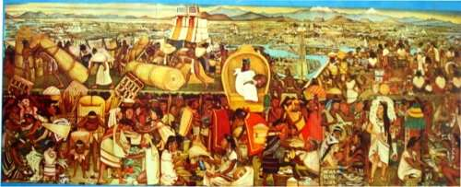
Native Voices
After annotating passages from Native American essays and stories, students will be able to identify native views of “human nature” completing summaries that include events used to develop moral lesson in the story.

Slide 2
“The Sky Tree” & “Coyote Finishes His Work” &
OBJECTIVE: After a close reading of “The Sky Tree” and “Coyote Finishes His Work” students will be able to summarize Native American myths and compare how ARCHETYPAL CHARACTERS communicate views of HUMAN NATURE.
ESSENTIAL QUESTION: How do Native American myths use archetypes and figurative language to communicate moral lessons and views of human nature?
What is an archetype? Find definition and provide examples by looking on p. 21 of textbook.

Slide 3
The Trickster Archetype
Characters that are Master shapeshifters and masters of lying.
They an be both helpful and dangerous, but they are always creative.
They often reveal the weaknesses in authority.
What idea would this archetype communicate about HUMAN NATURE?

Slide 4
First read…
Number the Paragraphs.
Look at the title and use your background knowledge to predict what the author will be arguing in this story.
Quick-Read: 2 minutes
Skim through the article and LIST KEY words that seem to be important to what the story will be arguing or communicating.

Slide 5
Second: ANNOTATE
READ, DISCUSS and ANSWER TEXT BASED QUESTIONS BY COMPLETING DIALECTICAL JOURNAL.
Who are the story’s main characters? What archetypes do they represent?
How does the story depict the “state of nature”? Find examples of figurative language or imagery that support this depiction.
What moral lesson is communicated by the story’s resolution? What does it reveal about HUMAN NATURE?

Slide 6
After your 2nd read…
What is the author’s purpose in creating this TEXT? In other words, what is s/he trying to accomplish?
What is his central claim or argument?
Simple:
The __________argues/illustrates that ____________ is _______because______.
Sufficient:
According to ______, ____________.
Sophisticated:
In the _________, “________,” _____ asserts/ proposes/ claims _______________.

Slide 7
Summary Paragraph
TOPIC SENTENCE: What does the Huron story “The Sky Tree” reveal about human nature and experience?
INTRODUCTION TO EVIDENCE: Summarize the events in the story. Who are the archetypal characters?
EVIDENCE: Find specific examples of important actions by archetypal characters.
ANALYZE: What do these examples/ evidence reveal/ prove/ illustrate?
COMMENTARY: Compare the views on human nature and the state of nature expressed by these stories to those of Hobbes and Rousseau? What do these Native American stories and myths provide for the American canon and culture today?

