Slide 1
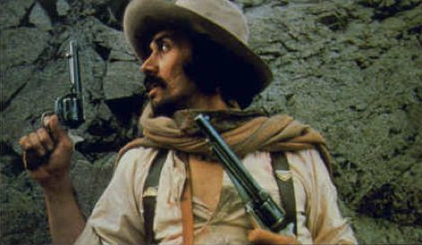
“The Ballad of Gregorio Cortez” a film by Robert Young
Based on the Americo Paredes classic book, With his pistol in his hand.. An anthropological and cultural study of the corrido and the significance of corridos in the culture and perspective of southern Texas.

Slide 2
The Background Story
Gregorio Cortez is accused of a murder of a Sheriff in 1901 Gonzalez, Texas.
A massive chase ensues involving over 600 men on train and horseback.
The chase lasts around two weeks
Cortez is eventually captured and put on trial.
The case generated a good deal of regional and national publicity and polarized the Mexican and Anglo communities.

Slide 3
Corridos as…
Symbolic forms of cultural and political resistance for Mexican Americans who were marginalized by Manifest Destiny.
A form of Social and artistic protest by Chicanos
Counter vocal: Corridos offer an alternative to dominant metanarratives.
Counter historical: Corridos are an alternate consideration of historical fact-Mexican community as agents of their own destiny.
Counter hegemonic: Corridos offer stories and narratives that challenge political authority of dominant group.

Slide 4
Viewing Questions
Describe the setting of the film’s story.
Who is the main character or protagonist? Describe what his physical and personality traits?
What is central conflict of the film?
What caused the central conflict?
Compare the the two communities in conflict. How does each view the problem at the the heart of the story?
What does the film depict as the motivation of Cortez’s pursuers?
What is the final outcome of events? What lesson or argument is communicated through the film’s depiction of the outcome of events?
Does Robert Young, the film’s director want his audience to be sympathetic of Cortez? What elements of the film convey that?

Slide 5
TERMS REVIEW
Metanarrative: Manifest Destiny
Counternarrative: Corridos and folk culture
Archetype: recurrent symbols in art and literature.
What do corrido personalities such as Joaquin Murrieta and Gregorio Cortez represent as symbolic archetypes for Mexican Americans? For Anglo Americans?

Slide 6
Cortez as the “mute silent other”
Narrative discourse dominated by Sheriff, attorneys, reporter, and Texas Rangers,-- non-Mexicans.
Cortez rarely speaks—only occasionally and sometimes to his horse.
Cortez as object, not subject—the objectification of Cortes.

Slide 7
Cortez as the “noble savage”
Cortez is depersonalized, admirable in his ability to elude capture, sacrificing, moral.
Cortez embodies an “animal-like closeness to nature.” His ability to outwit the posse, ability to survive alone in the wilderness, canny and resourceful.

Slide 8
Cortez as the ARCHETYPE

