Slide 1
Literary Term: APHORISM
An APHORISM is a brief cleverly worded statement that makes a wise observation about life.
Emerson’s style is aphoristic, in other words he incorporates many quotable sayings into his essays.
CHOOSE YOUR FAVORITE APHORISM IN THE ESSAYS “NATURE” OR “SELF RELIANCE”.

Slide 2
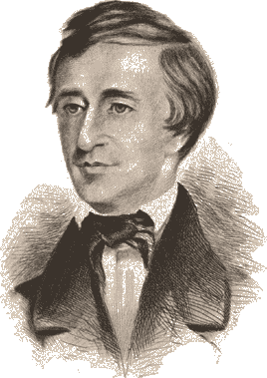
Thoreau Transcendentalism

Slide 3
Thoreau and the Politics of Transcendentalism
CA Focus Standard:
Objectives:
Define paradox.
Identify the main idea of Henry David Thoreau’s essays “Walden” and “Resistance to Civil Government” and explain how he uses paradox and figurative language as support.

Slide 4
After you watch preview video, use circle map info to write background paragraph.
Use the following paragraph frame:
_______can be described as ______. He was born
________ and spent most of his life________. While ________, he became interested in ________.
Additionally, ________________. His writing attempts to ______________ by _______________.
As you watch video, fill in circle map with important information about author’s background.
Author
Notes:
Have students use circle map to write a paragraph on Jonathan Edwards.

Slide 5
How does Thoreau fit into Transcendentalism?
After college, Thoreau befriended Emerson who introduced him to Transcendentalism
Since its publication in 1849, "Civil Disobedience" has inspired many leaders of protest movements around the world. This non-violent approach to political and social resistance has influenced American civil rights movement activist Martin Luther King Jr. and Mohandas Gandhi, who helped India win independence from Great Britain, among many others.
Thoreau coined the term “Civil Disobedience” when he chose to disobey a law he considered unjust

Slide 6
Key Beliefs of Transcendentalism
Natural Interconnectedness: People and nature are connected and reflect each other. “You know your individual nature through communion with nature.”
Individuality: Be true to YOURSELF! Individuals should not conform blindly to beliefs imposed on them by society. Trust your intuition over belief systems built to control you.
Spiritual self-reliance: Do not trust dogma or institutions. Nothing is more sacred than the integrity of our own individual mind. “You are sacred, because your spirit holds the divine within it. Religion or church cannot teach you about your spirit.”
Explain key beliefs of transcendentalism to your partner. (AC, BD)

Slide 7
Sentence Frames for identifying author’s main argument and purpose.
Simple:
The article argues that ____________.
Sufficient:
According to ______, ____________.
Sophisticated:
In the article, “________,” _____ asserts _______________.

Slide 8
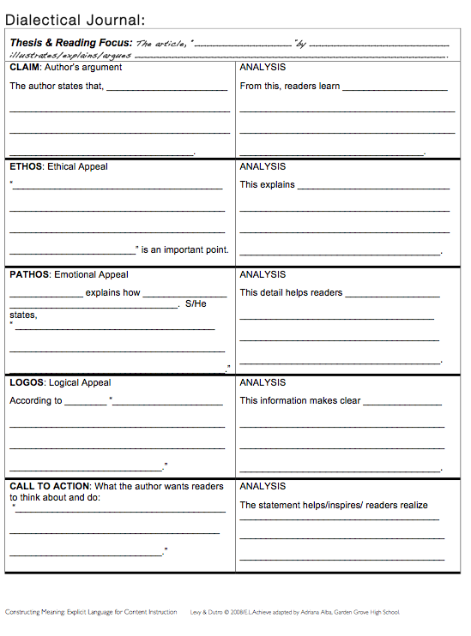
Dialectic Journal/Says-Means-Matters to cite and analyze text

Slide 9
Find a quote that expresses Key Beliefs of Transcendentalism
Natural Interconnectedness: People and nature are connected and reflect each other. “You know your individual nature through communion with nature.”
Individuality: Be true to YOURSELF! Individuals should not conform blindly to beliefs imposed on them by society. Trust your intuition over belief systems built to control you.
Spiritual self-reliance: Do not trust dogma or institutions. Nothing is more sacred than the integrity of our own individual mind. “You are sacred, because your spirit holds the divine within it. Religion or church cannot teach you about your spirit.”

Slide 10
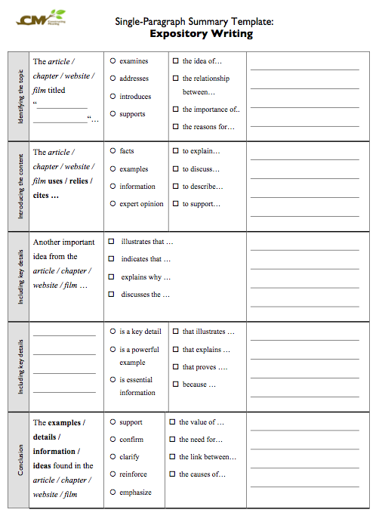
Summary Template to identify main idea and key details.

Slide 11
What is Paradox?
A statement that expresses the complexity of life by showing how opposing ideas can be both contradictory and true at the same time
Ex: To be free we have to have laws that limit our freedoms.
As you read…identify and analyze paradox in “Resistance to Civil Government” and determine its effects on Thoreau’s overall message.

Slide 12
Objective
Objective: After reading Henry David Thoreau’s essay “Resistance to Civil Government,” students will analyze the use of figurative language and paradox to support his beliefs about government and nature.
Evidence of Learning:
Thoreau Anticipation Guide
Read and Complete a Says-Means-Matters on “Resistance to Civil Government” by Henry David Thoreau

Slide 13
Reflection:
When protestors accept beatings, imprisonment, or even death as a consequence for disobeying laws they view as unjust, are they criminals or patriots?

