Slide 1
The Synthesis Essay

Slide 2
Objective
After completing notes on the basic parts of a an academic essay, and evaluating sample THESIS statements students will be able to:
Create a focused and clear THESIS STATEMENT;
Complete a THOROUGH OUTLINE that identifies guiding questions that will be answered in the essay
Use the outline to write synthesis essay.

Slide 3
Introduction:
Attention Getter: Introduce the topic that the prompt asks you to explore.
Necessary Background: Introduce the texts that are being explored to understand the topic. Include full name of author title of text and paraphrase necessary background.
Thesis Statement: Directly answer the prompt’s central question.

Slide 4
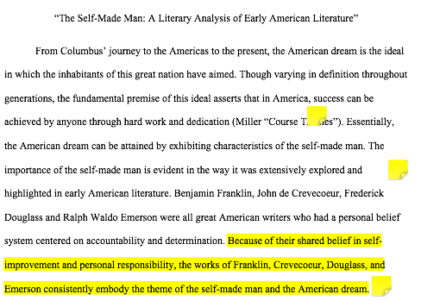

Slide 5
Body Paragraphs:
Topic Sentence:
Announces point to be made to support the THESIS statement.
Introduction to evidence:
Explain and elaborate on your point and set the context for evidence you will use by paraphrasing events.
Evidence Follow up with at least one quote.
Analysis: What does the evidence/example mean/signify/ denote/ indicate/ suggest?
Commentary: What does the evidence/example reveal/ prove/illustrate about the overall topic?

Slide 6
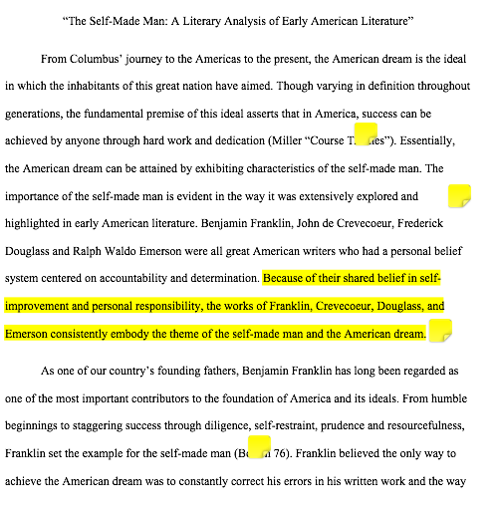
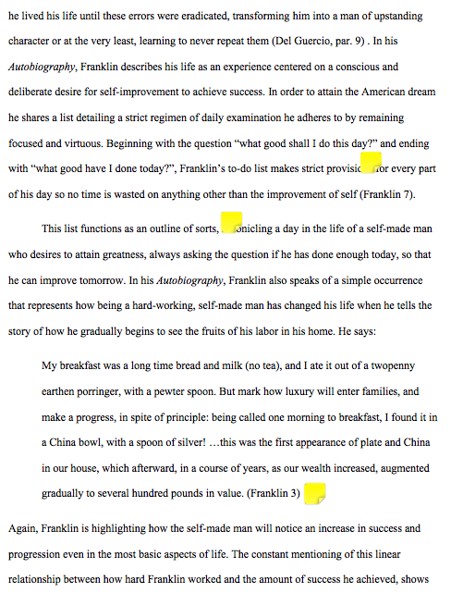

Slide 7
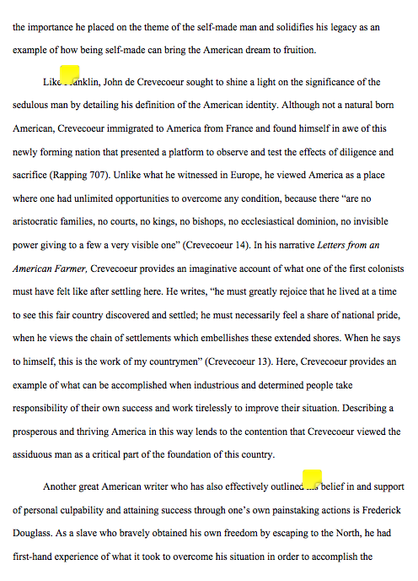
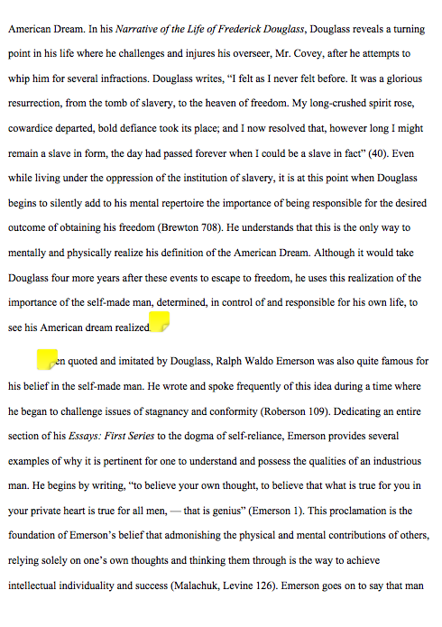

Slide 8
Conclusion
Restate thesis: Remind the reader what your essay just demonstrated or proved.
Review evidence:
Paraphrase points and evidence used to prove the thesis statement.
Relate: How do the texts studied and topic help us understand contemporary American identity and culture?

Slide 9
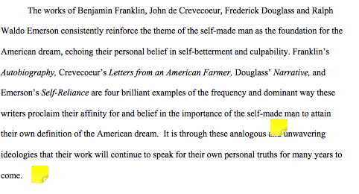

Slide 10
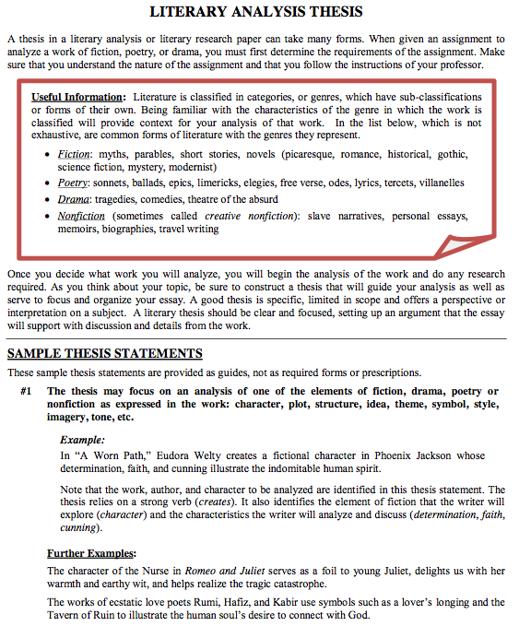
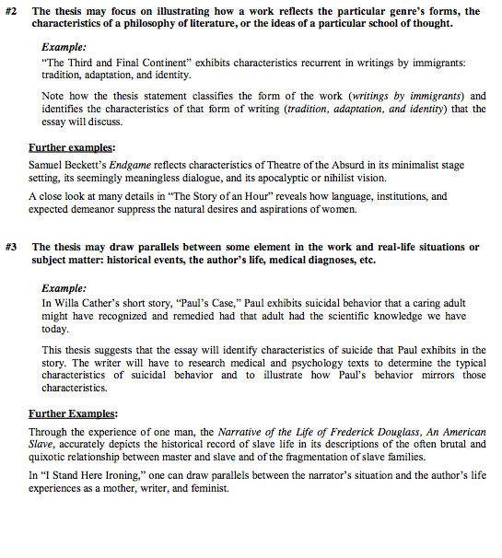
Part 2: THESIS STATEMENT

Slide 11
The Outline!
Paragraph 1: INTRODUCE SUBJECT & ANSWER PROMPT QUESTION
Paragraph 2: Decide on TOPIC & Create a TOPIC Question & Outline using TIE-AC GUIDING QUESTIONS
Paragraph 3: Decide on TOPIC & Create a TOPIC Question & Outline using TIE-AC GUIDING QUESTIONS
Paragraph 4: Decide on TOPIC & Create a TOPIC Question & Outline using TIE-AC GUIDING QUESTIONS
Paragraph 5: CONCLUDE

Slide 12
Final Draft Due:

