Slide 1
…with “Liberty” and “Justice” for ALL?
OBJECTIVE: By completing notes on Rhetorical Triangle students will be able to define the strategies used by writers to communicate their views and opinions on (IN)Justice.

Slide 2
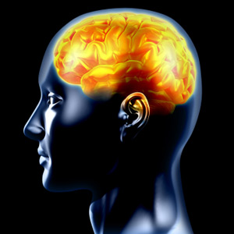
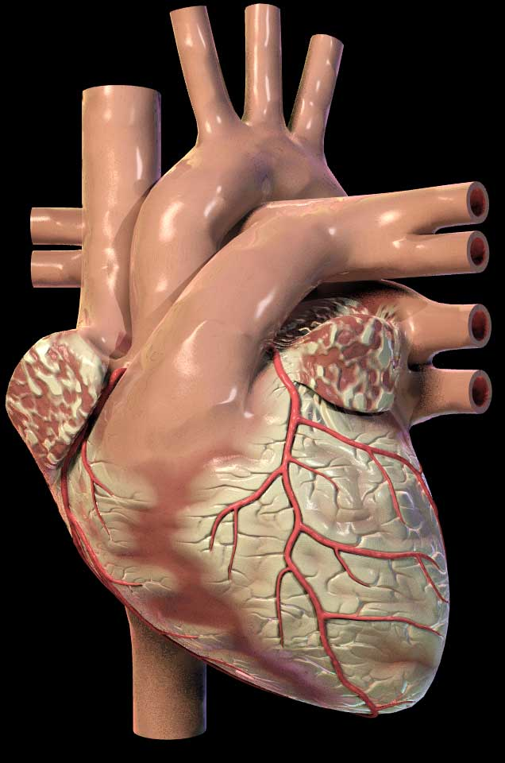
Rhetorical Devices or Persuasive Strategies
LOGICAL APPEALS
a.k.a. LOGOS
EMOTIONAL APPEALS
a.k.a. PATHOS
ETHICAL APPEALS
a.k.a. ETHOS
Using facts and logic to convince audience.
Using emotions to convince the audience.
Establish credibility and appeal to your readers’ ethics and/or moral values.
For example:
A snickers bar is 280 calories. 4 out 5 doctors agree that eating one daily is not very healthy.
For example:
Your donation will help this puppy find a safe loving home and have a chance at a bright future.
For example:
Believe me, I have been through your struggle and I know what it is like to be unemployed.

Slide 3
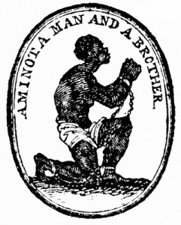
“Am I not a man and a brother?”
By Josiah Wedgwood
What argument is being made about justice by the image?
____ suggests ____ because ____.
____ argues ____ . For example, ___.
___ considers ___ to ___ because ___.
Find an example of:
Ethos: What makes the argument credible?
Pathos: What emotions does the image inspire? How does the image inspire such emotions?
Logos: What Logical argument is being made by the image? (facts, statistics, rhetorical questions, etc.)
Evaluate: What do you think made the image the most recognizable and emblematic of the Abolitionist movement?

