Slide 1
American Realism 1860-1920
UNIT GOAL: Write an expository essay that evaluates how REALIST artists and author’s effectively use ethos, pathos, and/or logos to communicate and support and their ideas about (in)justice.
Background paragraph on Realism
Gallery Walk on ideas about American (in)justice.

Slide 2
Introduction to American Realism
OBJECTIVES:
Define American Realism and identify its features.
Explain what caused the rise of realism
ACTIVITIES:
BELONGS or DOESN’T
Notes on Cause & Effect Map
EVIDENCE of your learning:
You will use notes & cause and effect map to write a paragraph that defines American Realism and explains historical context which caused its rise as a literary movement.

Slide 3
BELONGS or DOESN’T
You will be shown a series of pictures and text.
The pictures and text will depict relationships.
Determine which belong and which do not and why.

Slide 4
What is realism?
“Realism is nothing more and nothing less than the truthful treatment of material.” --William Dean Howells, “Editor’s Study,” Harper's New Monthly Magazine (November 1889), p. 966.

Slide 5
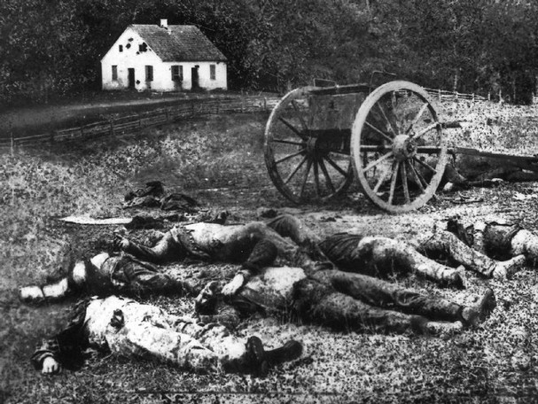
THIS IS REALISM

Slide 6
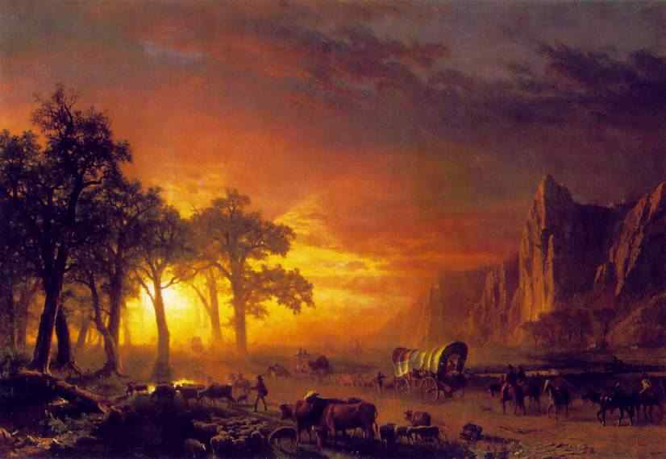
THIS IS NOT REALISM

Slide 7
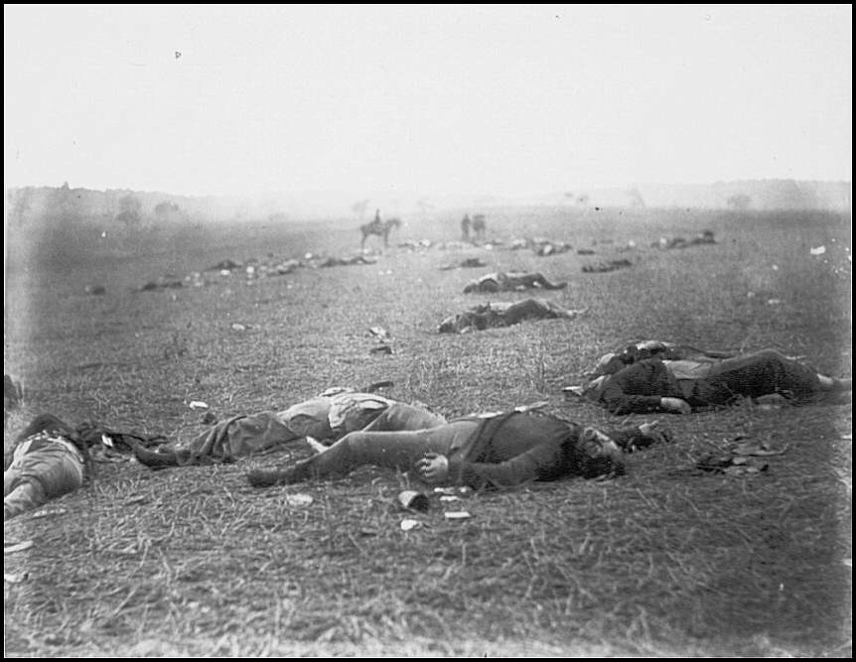
THIS IS REALISM

Slide 8
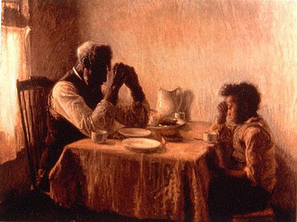
THIS IS REALISM

Slide 9
IS THIS REALISM?

Slide 10
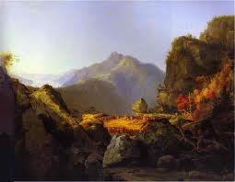
IS THIS REALISM?

Slide 11
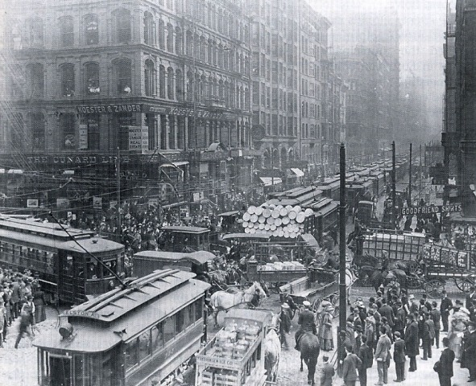
IS THIS REALISM?

Slide 12
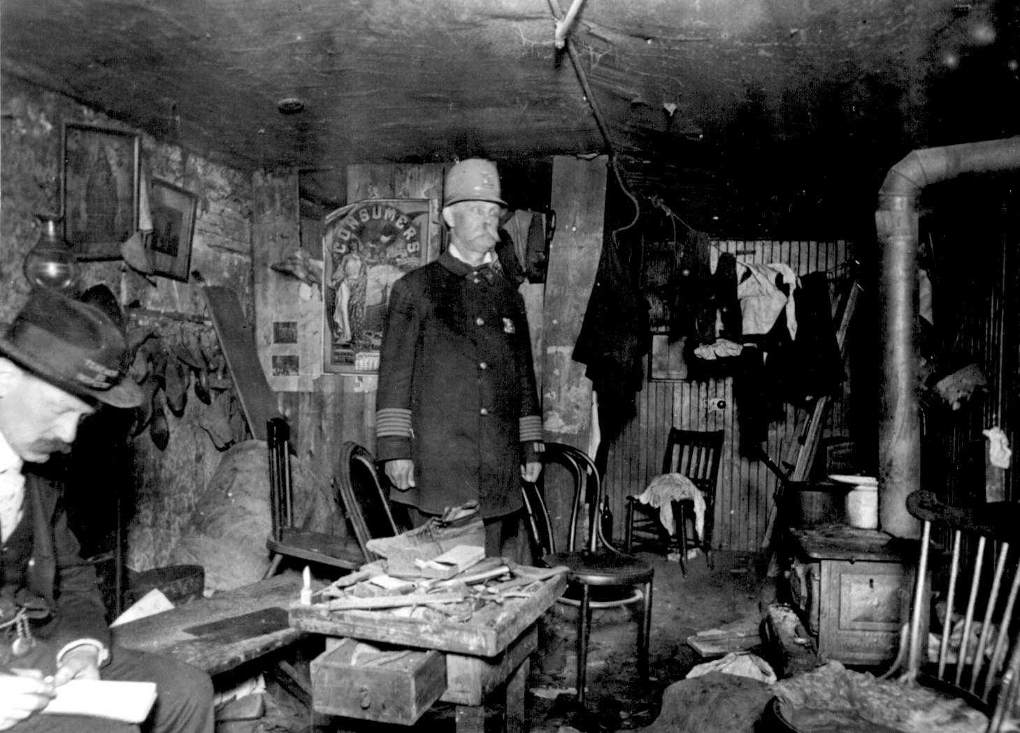
IS THIS REALISM?

Slide 13
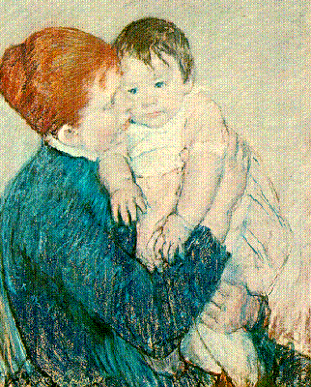
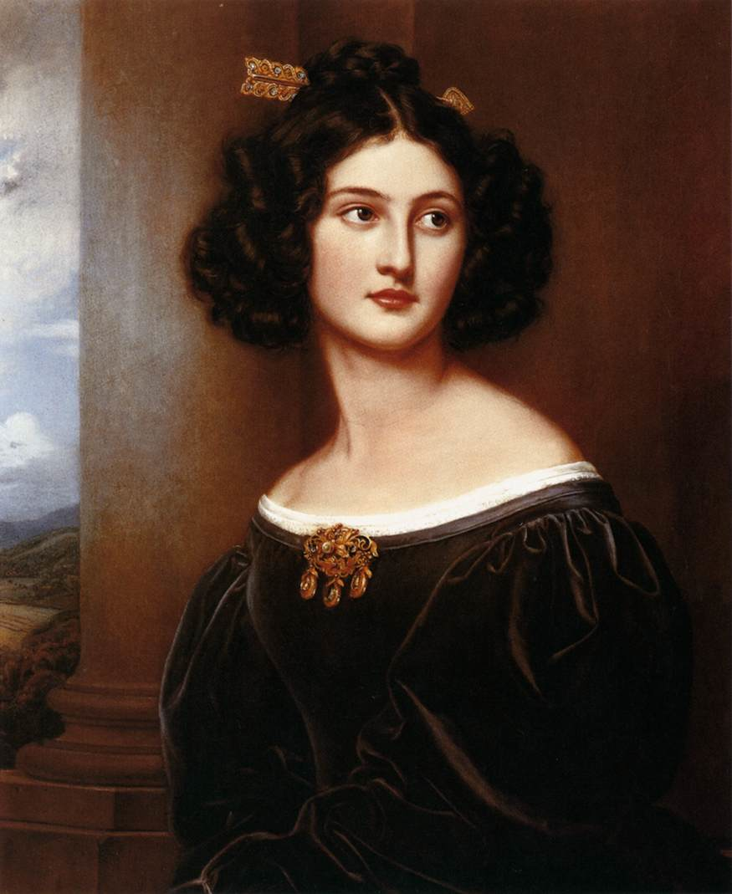
Which is REALISM?

Slide 14
By completing a cause and effect map, you will be able to define REALISM explain its historical causes.
CAUSES
What is REALISM?
When did it gain momentum as a literary movement?
What are its features? How is it different from Romanticism? Rationalism?

Slide 15
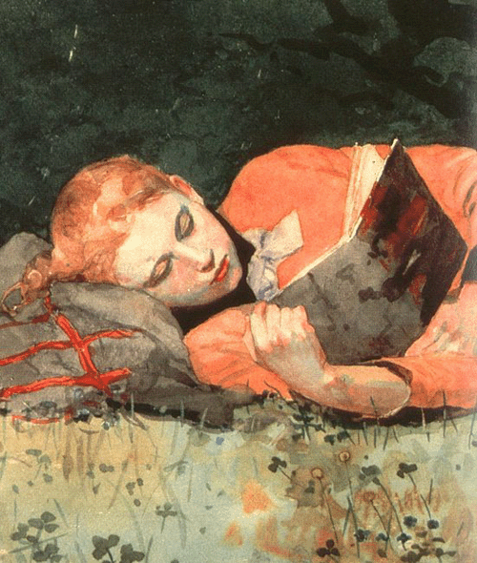
What is Realism?
A movement which called for faithful representation of reality in literature, also known as “verisimilitude” through the use of heavy details.
Emphasis on development of realistic, believable characters.
Dialogue that sounds like the real thing. Thus, written in natural vernacular, or dialect—characteristic language habits of a particular community it is aiming to represent.
Prominent from 1860-1890.

Slide 16
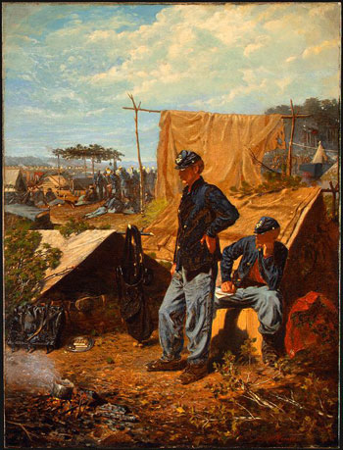
Why did Realism develop? THE CIVIL WAR
The Civil War inspired a reaction to Romanticism.
The conflict between regions was ugly and not Romantic at all.

Slide 17
Why did Realism develop? CITIES & IMMIGRATION
The urbanization and industrialization of America brought created a new reality and a new American to be represented.
Upheaval and social change in the latter half of the 19th century

Slide 18
Why did Realism develop? LITERACY RATES
A new middle class and increasing rates of democracy and literacy
Poor people and women were learning to read and they wanted to see themselves represented.

Slide 19
CAN YOU DEFINE “REALISM” & DESCRIBE ITS CAUSES?
EVIDENCE: Use your cause and effect map and notes to write a paragraph that defines REALISM and describes its causes. You may use the following paragraph frame for support.
_____________ can be defined as________. Artistic features and attitudes of __________ include _____________. This movement gained popularity during _________. It was caused by _______________. Another reason that _____, was _____. Additionally, _______________. In contrast to ROMANTICISM, it is concerned/interested/fascinated _____________.

