Slide 1
American Realism
UNIT GOAL: Write an expository essay that evaluates how REALIST artists and author’s effectively use ethos, pathos, and/or logos to communicate and support and their ideas about (in)justice.
Background paragraph on Realism
Gallery Walk on ideas about American (in)justice.
The Rhetorical Triangle: Ethos, Pathos, Logos

Slide 2
…with “Liberty” and “Justice” for ALL?
OBJECTIVE: By completing notes on Rhetorical Triangle students will be able to define the strategies used by Realist writers to communicate their views and opinions on (IN)Justice.

Slide 3
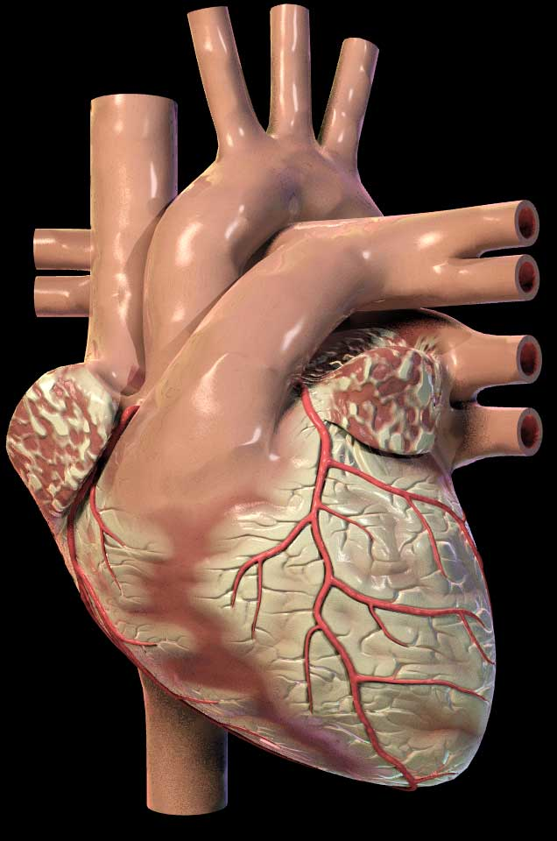
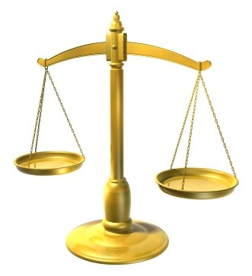
Rhetorical Devices or Persuasive Strategies
LOGICAL APPEALS
a.k.a. LOGOS
EMOTIONAL APPEALS
a.k.a. PATHOS
ETHICAL APPEALS
a.k.a. ETHOS
Using facts and logic to convince audience.
Using emotions to convince the audience.
Establish credibility and appeal to your readers’ ethics and/or moral values.
For example:
A snickers bar is 280 calories. 4 out 5 doctors agree that eating one daily is not very healthy.
For example:
Your donation will help this puppy find a safe loving home and have a chance at a bright future.
For example:
Believe me, I have been through your struggle and I know what it is like to be unemployed.

Slide 4
…with “Liberty” and “Justice” for ALL?
OBJECTIVE: After CLOSE READING an excerpt from Frederick Douglass’s “What to the Slave is the Fourth of July?” students will analyze the use of IMAGERY & the rhetorical triangle (ethos, pathos, logos) to support his philosophical beliefs about (in)justice.
Evidence:
Annotations and Marginalia
SAYS-MEANS-MATTERS
Expository Summary
SOAPS

Slide 5
After you share with your partner, use circle map info to write background paragraph.
Use the following paragraph frame:
_______can be described as ______. He was born
________ and spent most of his life________. While ________, he became interested in ________.
Additionally, ________________. His writing attempts to ______________ by _______________.
As you watch video, fill in circle map with important information about the author’s background.
Frederick Douglass
Notes:
Have students use circle map to write a paragraph on Jonathan Edwards.

Slide 6
Before you read… 1st read
Number the Paragraphs.
Look at the title and use your background knowledge to predict what he will be arguing in this essay.
Quick-Read: 3 minutes
Skim through the article and circle KEY words that seem to be important to what he will be arguing or communicating.

Slide 7
As you read… 2nd read
Underline phrases which help you answer the following:
What is the author’s purpose in writing this speech? In other words, what is he trying to accomplish?
What is his central claim or argument about justice?
How does he use ethos, pathos, logos to accomplish his purpose and communicate his argument?

Slide 8
After your 2nd read…
What is the author’s purpose in writing this essay? In other words, what is he trying to accomplish?
What is his central claim or argument?
Simple:
The speech argues that ____________.
Sufficient:
According to ______, ____________.
Sophisticated:
In the speech, “________,” _____ asserts/ proposes/ claims _______________.

Slide 9
THIRD read: MARGINALIA
Explain your annotations along the margins:
* Identify and Summarize Main Ideas: i.e. This explains that___.
✔ Evidence used to support argument:
i.e. This demonstrates/ illustrates/conveys.
? Clarify questions and confusion:
i.e. I don’t understand ____. What does ___ mean? I wonder why____.

Slide 10
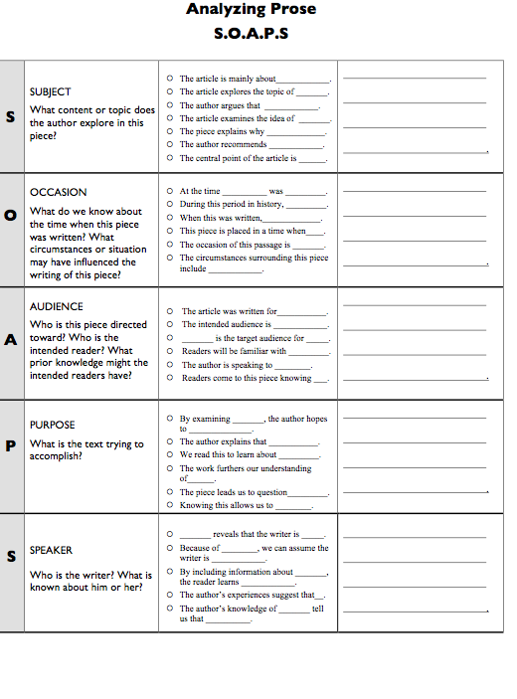
COMPLETE SOAPS TEMPLATE TO IDENTIFY AUTHOR’S PURPOSE & CONTEXT

Slide 11
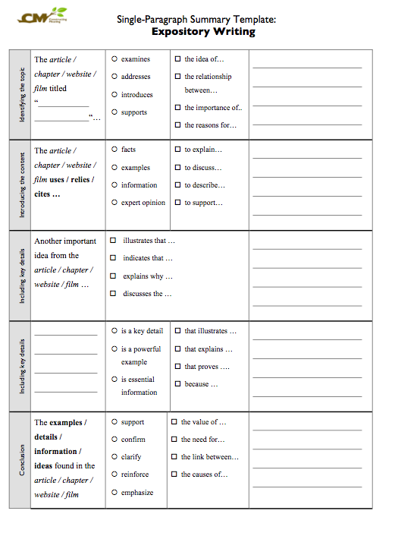
COMPLETE SUMMARY TEMPLATE SUMMARIZE SPEECH’s MAIN IDEAS

