Slide 1
American Realism
UNIT GOAL: Write an expository essay that evaluates how REALIST artists and author’s effectively use ethos, pathos, and/or logos to communicate and support and their ideas about (in)justice.
Background paragraph on Realism
Gallery Walk on ideas about American (in)justice.
The Rhetorical Triangle: Ethos, Pathos, Logos
Identified Ethos, Pathos, Logos in “Am I not A Man and a Brother”
Analyzed the use of the rhetorical triangle in “Narrative of the Life of Frederick Douglass” to convey views of JUSTICE.

Slide 2
…with “Liberty” and “Justice” for ALL?
OBJECTIVE: After CLOSE READING Mark Twain’s essay, “The Lowest Animal,” students will analyze the use of SATIRE AND IRONY as a part the rhetorical triangle (ethos, pathos, logos) to support his philosophical beliefs about (in)justice.
Evidence:
Annotations and Marginalia
Dialectical Journal
SOAPS
Progress Check

Slide 3
After you share with your partner, use circle map info to write background paragraph.
Use the following paragraph frame:
_______can be described as ______. He was born
________ and spent most of his life________. While ________, he became interested in ________.
Additionally, ________________. His writing attempts to ______________ by _______________.
As you watch video, fill in circle map with important information about the author’s background.
Mark Twain
Notes:
Have students use circle map to write a paragraph on Jonathan Edwards.

Slide 4
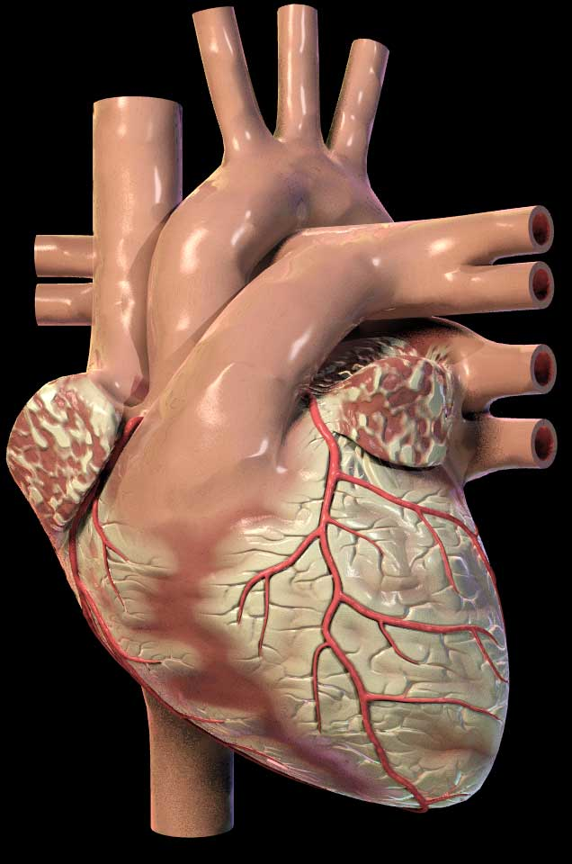
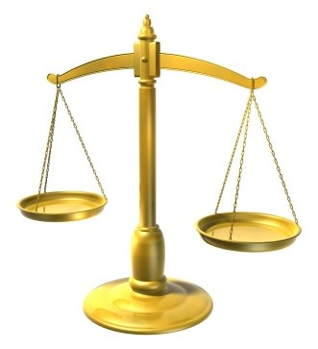
Rhetorical Devices or Persuasive Strategies
LOGICAL APPEALS
a.k.a. LOGOS
EMOTIONAL APPEALS
a.k.a. PATHOS
ETHICAL APPEALS
a.k.a. ETHOS
Using facts and logic to convince audience.
Using emotions to convince the audience.
Establish credibility and appeal to your readers’ ethics and/or moral values.
For example:
A snickers bar is 280 calories. 4 out 5 doctors agree that eating one daily is not very healthy.
For example:
Your donation will help this puppy find a safe loving home and have a chance at a bright future.
For example:
Believe me, I have been through your struggle and I know what it is like to be unemployed.

Slide 5
TERMS: Define Satire & Irony
Satire uses humor to critique people, traditions, and/ or institutions with the intention of improving or changing them.
TWO SATIRICAL TECHNIQUES:
1. EXAGGERATION, overstating something to make it look ridiculous.
2. IRONY: Stating the opposite of what is really meant.

Slide 7
What is being satirized? The idea that ________ is being satirized by showing/depicting/ illustrating____________. What is ironic about the image? The image is ironic because________.

Slide 8
A Satirical and Ironic Take on Social Darwinism

Slide 9
Before you read… 1st read
Number the Paragraphs.
Look at the title and use your background knowledge to predict what he will be arguing in this essay.
Quick-Read: 3 minutes
Skim through the article and circle KEY words that seem to be important to what he will be arguing or communicating.

Slide 10
As you read… 2nd read
Underline phrases which help you answer the following:
What is the author’s purpose in writing this speech? In other words, what is he trying to accomplish?
What is his central claim or argument about justice?
How does he use ethos, pathos, logos to accomplish his purpose and communicate his argument?

Slide 11
After your 2nd read…
What is the author’s purpose in writing this essay? In other words, what is he trying to accomplish?
What is his central claim or argument?
Simple:
The text argues that ____________.
Sufficient:
According to ______, ____________.
Sophisticated:
In the speech, “________,” _____ asserts/ proposes/ claims _______________.

Slide 12
THIRD read: MARGINALIA
Explain your annotations along the margins:
* Identify and Summarize Main Ideas: i.e. This explains that___.
✔ Evidence used to support argument:
i.e. This demonstrates/ illustrates/conveys.
? Clarify questions and confusion:
i.e. I don’t understand ____. What does ___ mean? I wonder why____.

Slide 13
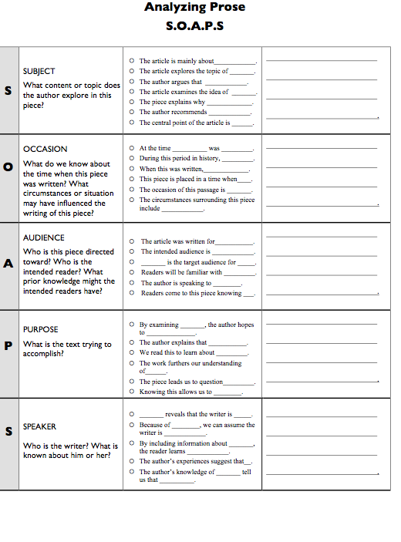
COMPLETE SOAPS TEMPLATE TO IDENTIFY AUTHOR’S PURPOSE & CONTEXT

Slide 14
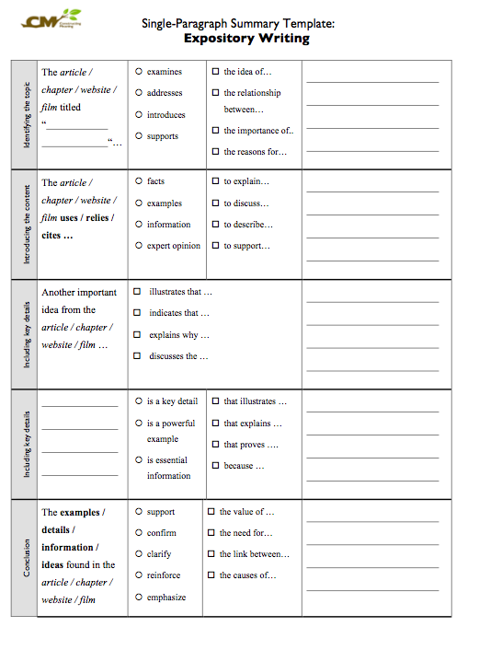
COMPLETE SUMMARY TEMPLATE SUMMARIZE SPEECH’s MAIN IDEAS

