Slide 1
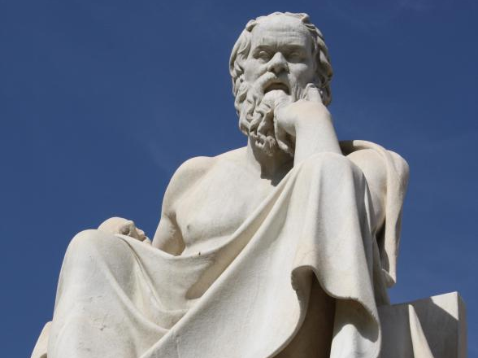
By participating in
Socratic Seminar
Scholars will practice academic behavior and language that
will be expected in a 21st century classroom & worksplace.

Slide 2
Socratic Seminar #1
WHY ETHNIC STUDIES?
OBJECTIVE: SWBAT 1.) Prepare for Socratic Seminar discussion on the value of ETHNIC STUDIES.
2.) Gain a deeper understanding of arguments for and against ETHNIC STUDIES Socratic Seminar Preparation Guide which includes focus questions and annotations of the text.

Slide 3
What is a Socratic Seminar?
Socratic seminar is a method of teaching developed by Socrates. He engaged his students in intellectual discussion by responding to questions with questions, instead of answers. This method encouraged the students to think for themselves rather than being told what to think.

Slide 4
By participating in a Socratic Seminar you will practice academic behavior that will be expected in college and/or the workplace environment. This behavior includes: LISTENING, ASKING, AND DISCUSSING

Slide 5
YOU SHOW ACADEMIC BEHAVIOR by
a. Participating when it is your turn to speak.
b. Expressing yourself clearly in sophisticated language.
c. Respecting others by avoiding side conversation and rude behaviors such as negative body language.
d. Speaking when it only when it is your turn and not interrupting or cutting someone off.
e. Making logical comments that are related to the text and purpose being discussed.

Slide 6
Texts:
From NOAH REMNICK “Why Ethnic Studies are Good for California and America”
Mark Lacey “Rift in Arizona as Latino Class is Found Illegal”
Purpose of the Seminar:
Discuss the value of Ethnic Studies Programs.
Identify and evaluate arguments of proponents and opponents of ETHNIC STUDIES PROGRAM.
Additionally, students will develop their own opinion on the TOPIC.

Slide 7
First read…
Number the Paragraphs.
Underline the title and use it along with your background knowledge to predict what author will be arguing in this text.
Quick-Read: 3 minutes
Skim through the article and circle KEY words that seem to be important to what he will be arguing or communicating.

Slide 8
SECOND READ: Explain your annotations with MARGINALIA
* Identify and Summarize Main Ideas: i.e. This explains that___.
✔ Evidence used to support argument:
i.e. This demonstrates/ illustrates/conveys…
? Clarify questions and confusion:
i.e. I don’t understand ____. What does ___ mean? I wonder why____.

Slide 9
After your 2nd read…
What is the author’s purpose in writing this essay? In other words, what is he trying to accomplish?
What is his central claim or argument?
Simple:
The texts argues that ____________ _______because______.
Sufficient:
According to ______, ____________.
Sophisticated:
In the article, “________,” _____ asserts/ proposes/ claims _______________.

Slide 10
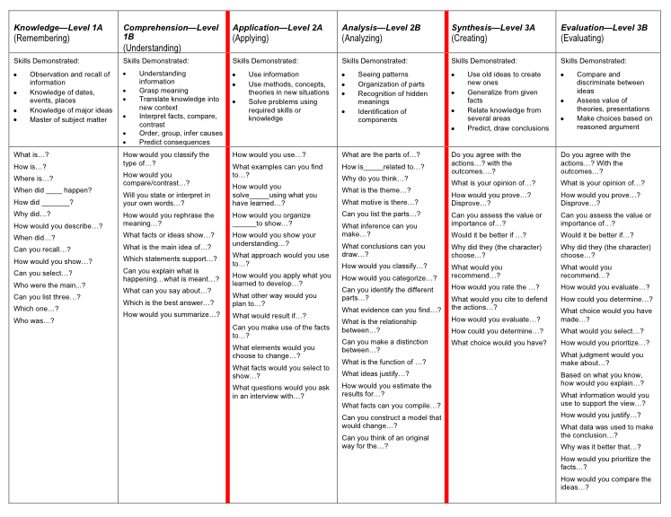

Slide 11
In your groups, choose the three BEST questions.
Students will generate three prompts on the right-hand side of their Cornell Notes.
Students should keep the Focus Questions for the Seminar in mind when designing their prompts.
Sample Prompt:
Describe the author’s purpose in writing the essay “Leviathan”.

Slide 12
I DO: Directions for Socratic Seminar

Slide 13
Students in the Inner-Circle
Students will take notes on the right side of their Cornell Notes
These notes can relate to the questions they created and/or their notes should reflect the critical points made by peers in the discussion.
Students can continue to generate questions and/or copy down questions of their fellow scholars to address.
Students in the Outer-Circle
Students will evaluate the participation of their A/B partner.
Students will meet and debrief with their A/B partner after the conclusion of the seminar.

Slide 14
INNER CIRCLE: YOU SHOW ACADEMIC BEHAVIOR by
a. Participating when it is your turn to speak.
b. Expressing yourself clearly in sophisticated language.
c. Respecting others by avoiding side conversation and rude behaviors such as negative body language.
d. Speaking when it only when it is your turn and not interrupting or cutting someone off.
e. Making logical comments that are related to the topic and issue being discussed and are backed up though evidence from the text.

Slide 15
OUTER CIRCLE
You show academic behavior by:
NOT TALKING!
Turning in the Socratic Seminar Participant form COMPLETED.
Writing your response to the BIG question.
Keeping track of your partner and discussion in the observation Observation Form and Final Thoughts.

Slide 16
PART THREE
BIG QUESTIONS FOR THE SEMINAR:
1.) What are the arguments for and against ETHNIC STUDIES PROGRAMS?
2.) Do you agree that ETHNIC STUDIES would benefits all California students regardless of background? Give examples from current events and/ or personal experiences.
3.) Should it be required as a part of the curriculum?

Slide 17
Sentence Frames to use as needed
To state an opinion
I believe ____ because…
I agree/disagree because…
I understand your point that ____; however,_____.
Although I agree with ___, I also believe that …
To ask a question
I am confused about …
Can someone explain…
I have questions about…
What does it mean when __says…?
When you__do you mean…?
To explain/elaborate
I’d also like to add that…
Evidence such as ____ suggests…
When ___, it is clear that…
Perhaps ___ can be interpreted as …
Another way to look at ____ is …

Slide 18
WRAP UP-Whip around
SCORE:
I liked when _______ said __________ because _______________.
An interesting idea _______________
Something I learned from the discussion ______________________.
I still don’t understand _____________.
Something that can improve_________.

Slide 19
Reflection:
TOPIC: Do you agree with Noah Remnick’s argument that ethnic studies programs will be beneficial to all?
INTRODUCE EVIDENCE: Why do you believe this?
EVIDENCE: Give two examples from the articles, lectures, and speakers to prove your point.
ANALYSIS: Explain how this example proves your point.
COMMENTARY: Should ethnic studies be required for all students in California?

