Slide 1
“SENIOR PICTURE DAY”
A short story by Michele Serros from
How to be a Chicana Role Model

Slide 2
Objective:
By close reading and discussing Michele Serros’s short story, “Senior Picture,” students will be able to analyze the narrator’s view of identity and relationship to “Indian” heritage.
Essential Question: What does the short story “Senior Picture Day” reveal about the narrator’s identity and her relationship to an “Indian” heritage?

Slide 3
Quote Response
“Unless we base our sense of identity upon the truth of who we are, it is impossible to attain happiness.” –Brenda Shoshana

Slide 4
After your 2nd read…
Essential Question: What does the short story “Senior Picture Day” by Michele Serros, reveal about the narrator’s identity and her relationship to an “Indian” heritage?
Simple:
The short story reveals that ____________.
Sufficient:
Michele Serros’s short story “ ________” reveals_________________.
Sophisticated:
In the short story, “________,” _____ illustrates/describes/depicts _______________.

Slide 5
IDENTITY

Slide 6
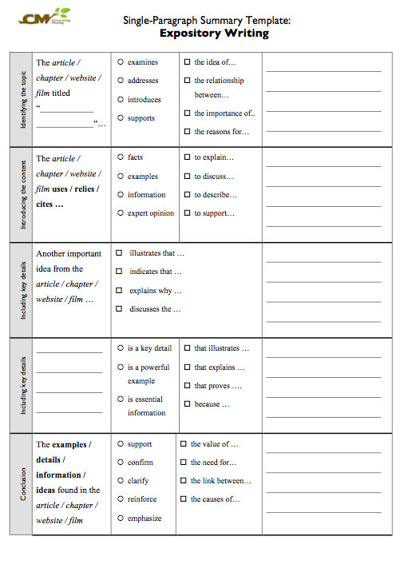
COMPLETE SUMMARY TEMPLATE THE STORY’s MAIN IDEAS

Slide 7
Quote Response
“Unless we base our sense of identity upon the truth of who we are, it is impossible to attain happiness.” –Brenda Shoshana
What does Michele Serros story reveal about the “truth” about identity.

