Slide 1
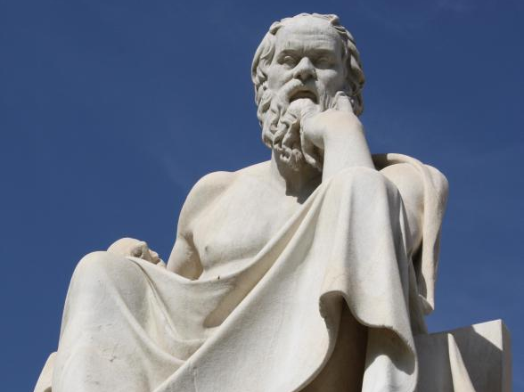
By participating in
Socratic Seminar
Scholars will practice academic behavior and language that
will be expected in a 21st century classroom & worksplace.

Slide 2
Socratic Seminar
UNIVERSAL CONCEPT:
Disillusion with the American Dream
OBJECTIVE: SWBAT 1.) Prepare for Socratic Seminar discussion of Modernist views of the American Dream
2.) Gain a deeper understanding of how Modernist art and thought shaped American views by the Socratic Seminar Preparation Guide which includes focus questions and annotations of the text.

Slide 3
What is a Socratic Seminar?
Socratic seminar is a method of teaching developed by Socrates. He engaged his students in intellectual discussion by responding to questions with questions, instead of answers. This method encouraged the students to think for themselves rather than being told what to think.

Slide 4
By participating in a Socratic Seminar you will practice academic behavior that will be expected in college and/or the workplace environment. This behavior includes: LISTENING, ASKING, AND DISCUSSING

Slide 5
YOU SHOW ACADEMIC BEHAVIOR by
a. Participating when it is your turn to speak.
b. Expressing yourself clearly in sophisticated language.
c. Respecting others by avoiding side conversation and rude behaviors such as negative body language.
d. Speaking when it only when it is your turn and not interrupting or cutting someone off.
e. Making logical comments that are related to the text and purpose being discussed.

Slide 6
TOPIC: The Archetype of Jay Gatsby
Texts:
The Great Gatsby by F. Scott Fitzgerald
Purpose of the Seminar:
Students will explore the universal concept of the American Dream as it is exhibited in Modernist literature such as, The Great Gatsby.
Additionally, students will evaluate the influence of American Modernist texts and ideas on American culture and society.

Slide 7
Part 1: Generate Questions Using Academic Terms

Slide 8
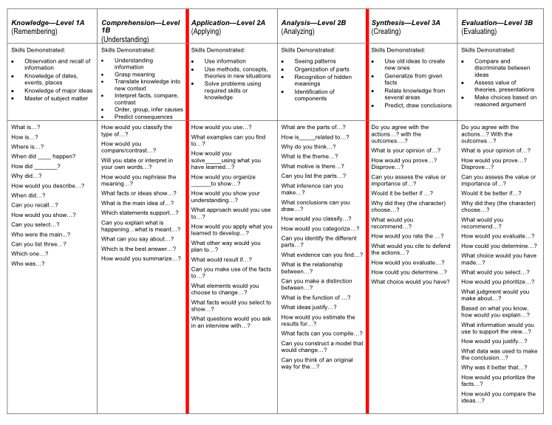

Slide 9
In your groups, choose the FOUR BEST questions for discussion: 5 Minutes
Students will generate four prompts on the right-hand side of their Cornell Notes by using Question Guide.
Students should keep the OBJECTIVES for the Seminar in mind when designing their discussion prompts.

Slide 10
TEAM LEAD
Make sure each team member has all questions answered and provides quotes or evidence from the text or from real life experiences.
Choose how you want the answers created:
Everyone answers together?
Each person answers one question and provides it for the rest of the group?

Slide 11
Part II: Directions for Socratic Seminar

Slide 12
Students in the Inner-Circle
Keep the conversation going by asking questions, stating opinions, bringing others in to the conversation, comment on colleague’s points.
Use notebooks as support.
Refer to the text as back up or evidence.
Students in the Outer-Circle
Students will evaluate the participation of their A/B partner by completing Socratic Seminar form.
Document conversation by taking notes on questions asked.
Support Inner Circle member by providing them with post-it suggestions.
Students will meet and debrief with their A/B partner after the conclusion of the seminar.

Slide 13
INNER CIRCLE: YOU SHOW ACADEMIC BEHAVIOR by
Contributing to discussion at least three times with questions, comments, or opinions. [ ] YES
Expressing themselves clearly in sophisticated academic language. [ ] YES
Respecting others by avoiding side conversation and rude behaviors. [ ] YES
Speaking only when it is their turn and bringing others into the conversation without interrupting or cutting someone off. . [ ] YES
Making logical comments that are related to the topic and issue being discussed and are backed up though evidence from the text. . [ ] YES

Slide 14
OUTER CIRCLE
Respecting others by avoiding side conversation and rude behaviors. [ ] YES
Turning in the Socratic Seminar Notes form COMPLETED with at least three questions, notes, and comments. [ ] YES
Evaluating your partner’s participation by completing Socratic Seminar Observation form . [ ] YES
Completing Seminar Evaluation FINAL THOUGHTS. [ ] YES
Participating in the conversation by taking the “Hot Seat.” [ ] YES

Slide 15
PART THREE: Discuss
OBJECTIVES:
Discuss the symbolic value of Jay Gatsby as a Modernist archetype.
Evaluate the influence of MODERNIST texts and ideas on American culture, society and literary themes.
1.) Who is Jay Gatsby and is he really great? What qualities revealed through the first half of the book make him an archetypal antihero?
2.) What ideas about the American Dream are conveyed through his character?
3.) Compare Gatsby to Emerson’s Romantic Idealist.

Slide 16
Sentence Frames to use as needed
To state an opinion
I believe ____ because…
I agree/disagree because…
I understand your point that ____; however,_____.
Although I agree with ___, I also believe that …
To ask a question
I am confused about …
Can someone explain…
I have questions about…
What does it mean when __says…?
When you__do you mean…?
To explain/elaborate
I’d also like to add that…
Evidence such as ____ suggests…
When ___, it is clear that…
Perhaps ___ can be interpreted as …
Another way to look at ____ is …

Slide 17
FINAL THOUGHTS: Whip around
Possible SCORES:
5 Superstar Scholars
4 Engaged High School Students
3 Confident 8th Graders
2 Insecure 7th Graders
1 Where was everyone?
COMMENTS:
I liked when _______ said __________ because _______________.
An interesting idea _______________
Something I learned from the discussion ______________________.
ROOM FOR IMPROVEMENT
I still don’t understand _____________.
DURING NEXT SOCRATIC SEMINAR…

