Slide 1
The Synthesis Essay

Slide 2
Objective
After completing notes on the basic parts of a an academic essay, and evaluating sample THESIS statements students will be able to:
Create a focused and clear THESIS STATEMENT;
Complete a THOROUGH OUTLINE that identifies guiding questions that will be answered in the essay
Use the outline to write essay.

Slide 3
Objective
After completing notes on the basic parts of a an academic essay, and evaluating sample essays, students will be able to:
Write a complete introduction.
Use the outline to write essay.

Slide 4
THE NO Fail FORMULA
Introduction: ANT
Body: TIEAC
Conclusion: RRR

Slide 5
Introduction:
Attention Getter: Introduce the topic that the prompt asks you to explore.
Necessary Background: Introduce the texts that are being explored to understand the topic. Include full name of author title of text and paraphrase necessary background.
Thesis Statement: Directly answer the prompt’s central question. Include key signal words. WARNING: If your thesis statement is vague and unclear, the rest of your essay will surely fall apart.

Slide 6
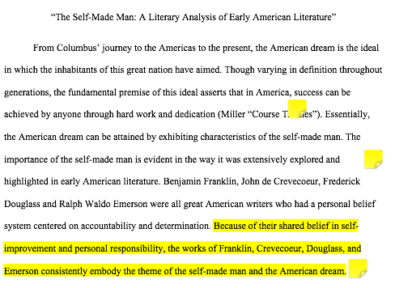

Slide 7
Body Paragraphs:
Topic Sentence:
Announces point to be made to support the THESIS statement.
Introduction to evidence:
Explain and elaborate on your point and set the context for evidence you will use by paraphrasing events.
Evidence Follow up with at least one quote.
Analysis: What does the evidence/example mean/signify/ denote/ indicate/ suggest?
Commentary: What does the evidence/example reveal/ prove/illustrate about the overall topic?

Slide 8
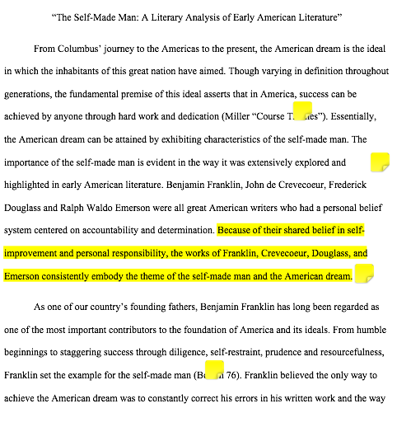
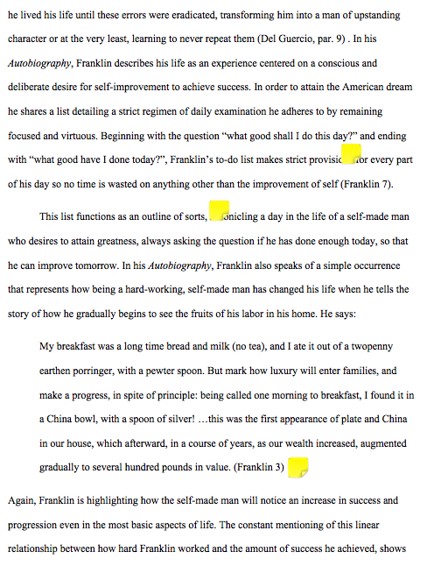

Slide 9
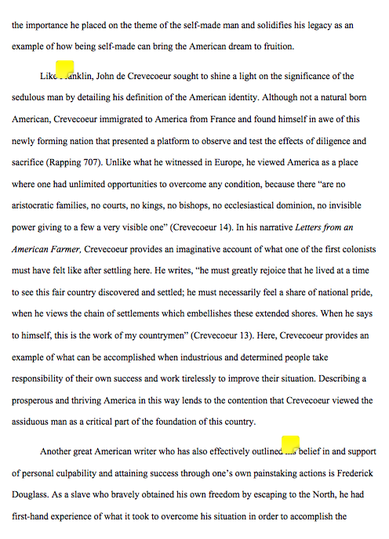
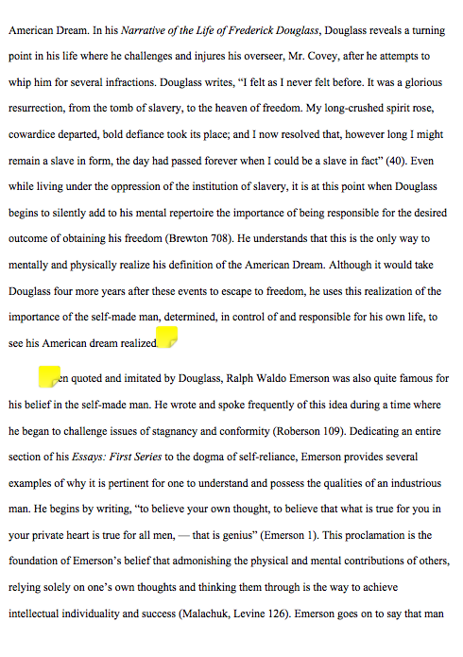

Slide 10
Conclusion
Restate thesis: Remind the reader what your essay just demonstrated or proved.
Review evidence:
Paraphrase points and evidence used to prove the thesis statement.
Relate: How do the texts studied and topic help us understand contemporary American identity and culture?

Slide 11
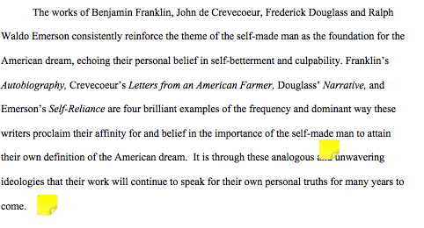

Slide 12
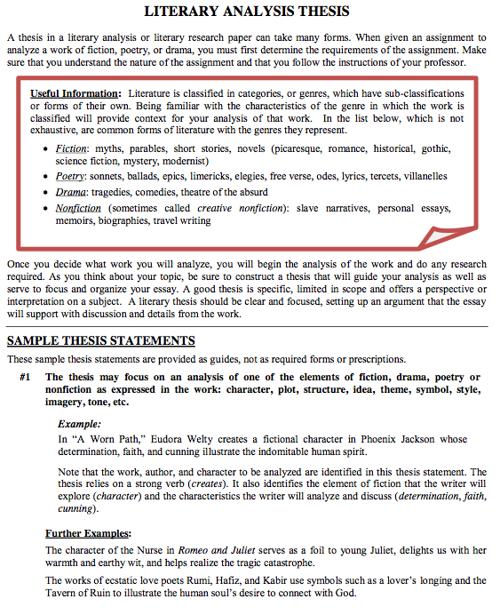
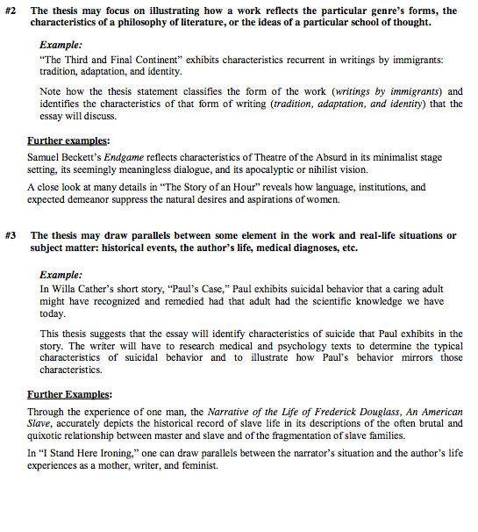
Part 2: THESIS STATEMENT

Slide 13
The Outline!
Paragraph 1: INTRODUCE SUBJECT & ANSWER PROMPT QUESTION
Paragraph 2: Decide on TOPIC & Create a TOPIC Question & Outline using TIE-AC GUIDING QUESTIONS
Paragraph 3: Decide on TOPIC & Create a TOPIC Question & Outline using TIE-AC GUIDING QUESTIONS
Paragraph 4: Decide on TOPIC & Create a TOPIC Question & Outline using TIE-AC GUIDING QUESTIONS
Paragraph 5: CONCLUDE

Slide 14
Final Draft Due:

