Slide 1
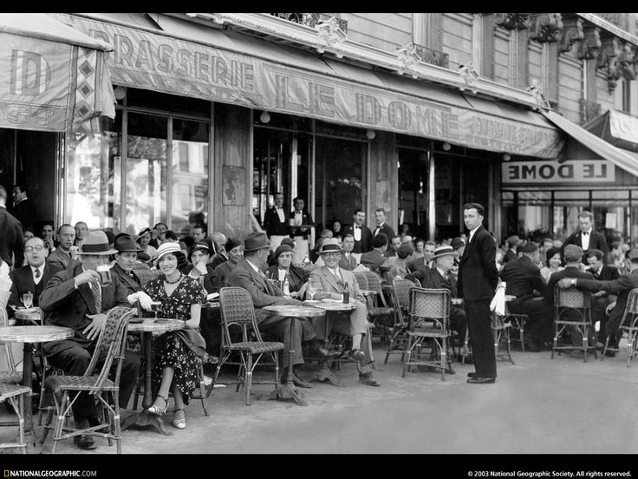
By participating in
World Café
Scholars will discuss and review TOPICS, MOVEMENTS, AUTHORS, and IDEAS
covered during first Semester of English 3P: American Literature Essentials.

Slide 2
World Café
The goal of a World Café is to engage a small group in meaningful, high-level discussions around a central topic, theme or question. A Café Conversation is a creative process for leading collaborative dialogue, sharing knowledge and building academic language.

Slide 3
World Café Instructions
There are TWO PARTS:
First, there are stations around the room that cover all the topics we covered this semester:
Rationalism
Puritanism
Romanticism
Transcendentalism
Dark Romanticism
Realism
DURING THE FIRST PART, which will be made up of 3 ROUNDS you will be visiting stations of YOUR CHOICE that your feel your knowledge is at EXPERT LEVEL.

Slide 4
World Café First Round
Each conversation will last 5 minutes.
Sessions will end and begin when time is called.
EVERYONE will grab a marker and answer the questions provided on poster paper.
Host will be determined by the cards.
Host will lead conversation and make sure all participants share knowledge.

Slide 5
World Café Questions
What were some of the key ideas of this literary movements?
What author best represents this movements? What was author’s overall message and position? Provide evidence to support.
What impact or influence has this literary movement had on present day American identity or culture?

Slide 6
World Café Second Round
DURING THE SECOND PART, which will be made up of 3 ROUNDS you will be visiting stations of YOUR CHOICE that your feel your knowledge is at BEGINNER LEVEL.
Each conversation will last 5 minutes.
Sessions will end and begin when time is called.
EVERYONE will grab a marker and answer the questions provided on NOTEBOOK PAGE.
Host will be determined by the cards.
Host will lead conversation and read previous responses.
sure all participants share knowledge.

Slide 7
World Café Questions
What were some of the key ideas of this literary movements?
What author best represents this movements? What was author’s overall message and position? Provide evidence to support.
What impact or influence has this literary movement had on present day American identity or culture?
Write a question that remains unclear or unanswered.

Slide 8
TICKET OUT: What will you take with you?
Whip Around one idea that you will remember beyond this semester.

