Slide 1
ARTIST NAME & COVER VISUAL
What ideas does the artist/ thinker/ musician communicate for the student of American culture?

Slide 2
Artist Biography
Picture
Include Web Credit <www.website.com>
Background Paragraph
Include Web Credit

Slide 3
TOOL: Use circle map info to write background paragraph.
Use the following paragraph frame:
_______can be described as ______. S/He was born
________ and spent most of his life________. While ________, he became interested in ________.
Additionally, ________________. Her/ His writing attempts to ______________ by _______________.
As you research, fill in circle map with important information about author’s background.
Artist
Notes:
Have students use circle map to write a paragraph on Jonathan Edwards.

Slide 4
Example of Works
Include representative works as they apply to the artist. These can include:
VIDEO
VISUAL
TEXT
Web Credit is required for all entries.

Slide 5
SUMMARY of WORK
TITLE of TEXT
Include bibliographical information.
Last Name, First Name, “Title of song/ story/ article.” Title of Book or website where it was found. web. Date of Access. <www.website.com>
SUMMARY PARAGRAPH: Use Summary Template in the next slide as support.

Slide 6
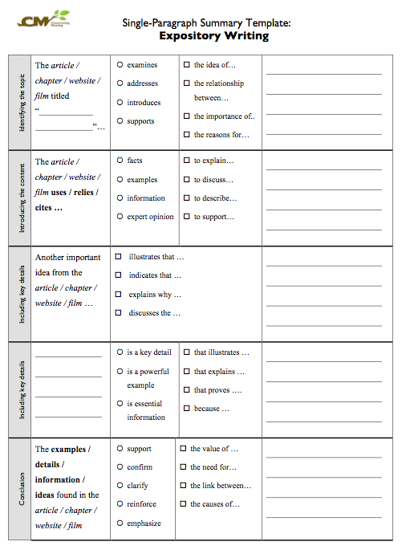
Summary Template to identify main idea and key details.

Slide 7
Context of WORK
TITLE of TEXT
Include bibliographical information.
Last Name, First Name, “Title of song/ story/ article.” Title of Book or website where it was found. web. Date of Access. <www.website.com>
SUMMARY PARAGRAPH: Use SOAPS Template in the next slide as support.

Slide 8
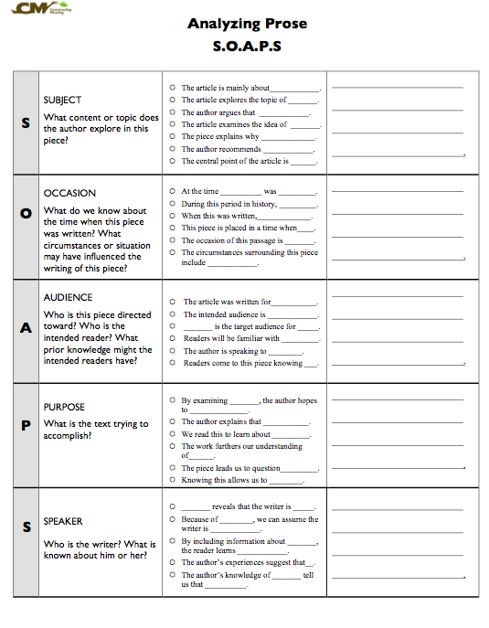
SOAPS Template to examine author’s purpose and context.

Slide 9
Harlem Renaissance Reflection
Answer the following questions:
What was the Harlem Renaissance? What ideas did this movement contribute to American culture?

Slide 10
Works Cited Page
Last Name, First Name, “Title of song/ story/ article.” Title of Book or website where it was found. web. Date of Access. <www.website.com>

