Slide 1
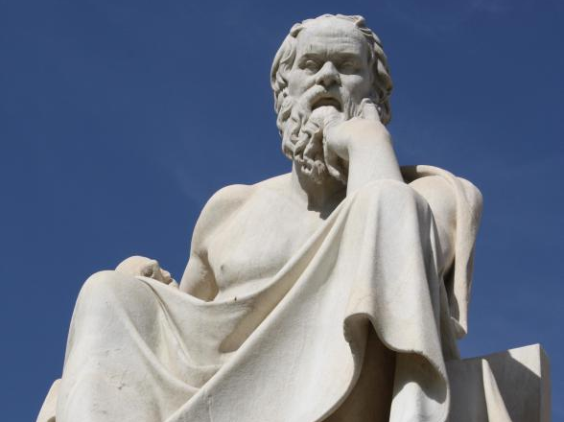
By participating in
Socratic Seminar
Scholars will practice academic behavior and language that
will be expected in a 21st century classroom & worksplace.

Slide 2
Socratic Seminar #2
UNIVERSAL CONCEPT:
AMERICA AS METAPHOR
OBJECTIVE: SWBAT 1.) Prepare for Socratic Seminar discussion of views of concept “AMERICA” and its implications on American Identity
2.) Gain a deeper understanding of framework of themes in American literary.

Slide 3
What is a Socratic Seminar?
Socratic seminar is a method of teaching developed by Socrates. He engaged his students in intellectual discussion by responding to questions with questions, instead of answers. This method encouraged the students to think for themselves rather than being told what to think.

Slide 4
By participating in a Socratic Seminar you will practice academic behavior that will be expected in college and/or the workplace environment. This behavior includes: LISTENING, ASKING, AND DISCUSSING

Slide 5
YOU SHOW ACADEMIC BEHAVIOR by
a. Participating when it is your turn to speak.
b. Expressing yourself clearly in sophisticated language.
c. Respecting others by avoiding side conversation and rude behaviors such as negative body language.
d. Speaking when it only when it is your turn and not interrupting or cutting someone off.
e. Making logical comments that are related to the text and purpose being discussed.

Slide 6
Texts:
“Letter from an American Farmer” by Hector St. John de Crevecoer
“Americans and the American Dream” by John Steinbeck
“Let America Be America Again” by Langston Hughes
Objective of the Seminar:
Students will explore the universal concept of the AMERICA & AMERICAN IDENTITY as its is exhibited in summer reading texts.
Additionally, students will evaluate the influence of these ideas on contemporary American culture and society.

Slide 7
First read…ANNOTATIONS
Number the Paragraphs.
Underline the title and use it along with your background knowledge to predict what author will be arguing in this text.
Quick-Read: 3 minutes
Skim through the article and circle KEY words that seem to be important to what he will be arguing or communicating.

Slide 8
SECOND READ: Explain your annotations with MARGINALIA
* Identify and Summarize Main Ideas: i.e. This explains that___.
✔ Evidence used to support argument:
i.e. This demonstrates/ illustrates/conveys… ETHOS, PATHOS, LOGOS
? Clarify questions and confusion:
i.e. I don’t understand ____. What does ___ mean? I wonder why____.
! Identify CALL TO ACTION

Slide 9
After your 2nd read…
What is the author’s PURPOSE and CENTRAL CLAIM or argument?
Simple:
The texts argues that ____________ _______because______.
Sufficient:
According to ______, ____________.
Sophisticated:
In the text, “________,” _____ asserts/ proposes/ claims _______________.

Slide 10
Part 1: Generate Questions Using Academic Terms

Slide 11
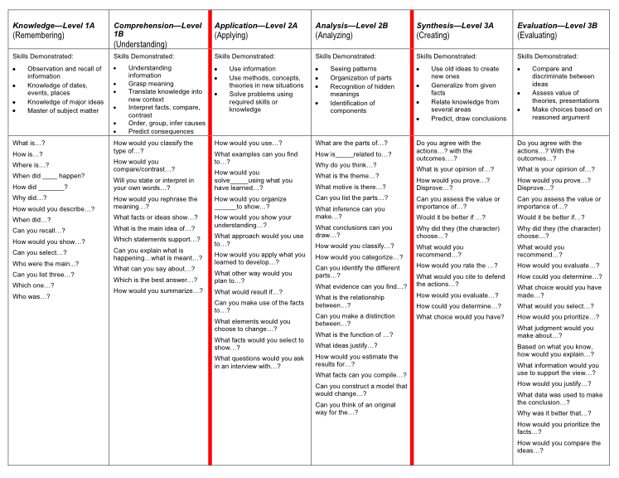

Slide 12
In your groups, choose the FOUR BEST questions for discussion: 5 Minutes
Students will generate three prompts on the right-hand side of their Cornell Notes by using Question Guide.
Students should keep the OBJECTIVES for the Seminar in mind when designing their discussion prompts.
Students will explore the universal concept of the AMERICA & AMERICAN IDENTITY as its is exhibited in summer reading texts.
Additionally, students will evaluate the influence of these ideas on contemporary American culture and society.

Slide 13
TEAM LEAD
Make sure each team member has all questions answered and provides quotes or evidence from the text or from real life experiences.
Choose how you want the answers created:
Everyone answers together?
Each person answers one question and provides it for the rest of the group?

Slide 14
I DO: Directions for Socratic Seminar

Slide 15
Students in the Inner-Circle
Students will take notes on the right side of their Cornell Notes
These notes can relate to the questions they created and/or their notes should reflect the critical points made by peers in the discussion.
Students can continue to generate questions and/or copy down questions of their fellow scholars to address.
Students in the Outer-Circle
Students will evaluate the participation of their A/B partner.
Students will meet and debrief with their A/B partner after the conclusion of the seminar.

Slide 16
INNER CIRCLE: YOU SHOW ACADEMIC BEHAVIOR by
Contributing to discussion at least three times with questions, comments, or opinions. [ ] YES
Expressing themselves clearly in sophisticated academic language. [ ] YES
Respecting others by avoiding side conversation and rude behaviors. [ ] YES
Speaking only when it is their turn and bringing others into the conversation without interrupting or cutting someone off. . [ ] YES
Making logical comments that are related to the topic and issue being discussed and are backed up though evidence from the text. . [ ] YES

Slide 17
OUTER CIRCLE
Respecting others by avoiding side conversation and rude behaviors. [ ] YES
Turning in the Socratic Seminar Notes form COMPLETED with at least three questions, notes, and comments. [ ] YES
Evaluating your partner’s participation by completing Socratic Seminar Observation form . [ ] YES
Completing Seminar Evaluation FINAL THOUGHTS. [ ] YES
Participating in the conversation by taking the “Hot Seat.” [ ] YES

Slide 18
PART THREE
We will meet the following OBJECTIVES:
Students will explore the universal concept of the AMERICA & AMERICAN IDENTITY as its is exhibited in summer reading texts.
Additionally, students will evaluate the influence of these ideas on contemporary American culture and society.
By answering the following ESSENTIAL QUESTIONS:
What defines the idea of “America” as both a political and cultural concept?
What are the qualities and characteristics of an “American Identity”? How has it changed over time?
How do American authors use stylistic and rhetorical devices to achieve purpose and convey ideas about “American Identity”?
Which author’s ideas do you dis/agree with? Why?

Slide 19
Sentence Frames to use as needed
To state an opinion
I believe ____ because…
I agree/disagree because…
I understand your point that ____; however,_____.
Although I agree with ___, I also believe that …
To ask a question
I am confused about …
Can someone explain…
I have questions about…
What does it mean when __says…?
When you__do you mean…?
To explain/elaborate
I’d also like to add that…
Evidence such as ____ suggests…
When ___, it is clear that…
Perhaps ___ can be interpreted as …
Another way to look at ____ is …

Slide 20
WRAP UP-Whip around
SCORE
I liked when _______ said __________ because _______________.
An interesting idea _______________
Something I learned from the discussion ______________________.
ROOM FOR IMPROVEMENT
I still don’t understand _____________.
IN THE NEXT SOCRATIC SEMINAR…

