Slide 1
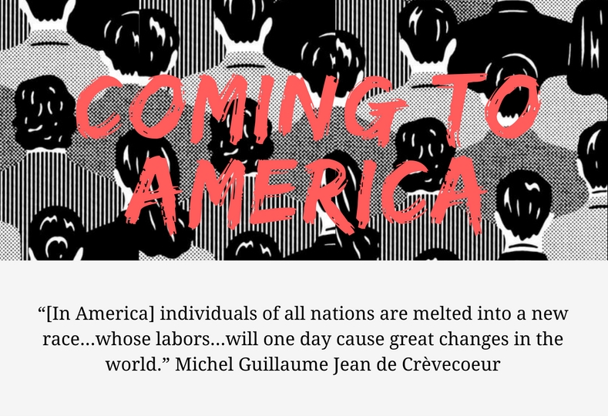

Slide 2
Reading Objective: After close reading “Balboa” (pp. 77-83) by Sabina Murray, students will be able to determine THEMES by analyzing CHARACTERIZATION and structure including the use of FLASHBACK and FORESHADOWING.

Slide 3
HOW WE GET THERE
PRE-READING:
Author’s Background
Vocabulary Preview
WHILE WE READ:
Close Read with Dialectical Journal
AFTER WE READ:
Summary & Progress Check

Slide 4
After you share with your partner, use circle map info to write background paragraph.
Use the following paragraph frame:
_______can be described as ______. S/He was born
________ and spent most of her/his life________. While ________, s/he became interested in ________.
Additionally, ________________. Her/His writing attempts to ______________ by _______________.
As you watch video, fill in circle map with important information about the author’s background.
Notes:
Have students use circle map to write a paragraph on Jonathan Edwards.

Slide 5
USE VOCABULARY TO PREDICT TONE & PURPOSE: Part 1
CIRCLE TERM: Does it look like another word you know? Does it have a prefix/suffix you recognize?
UNDERLINE CLUES: What do the words/sentences around it tell you about what the word might mean?
AROUND: What actions are going on in the sentence as a whole?
WRITE YOUR GUESS!

Slide 6
USE VOCABULARY TO PREDICT TONE & PURPOSE: Part 2
GIVE ONE GET ONE:
1. GIVE YOUR DEFINITION to fellow scholars.
2. GET DEFINITIONS to SELECTION WORDS.

Slide 7
USE VOCABULARY TO PREDICT TONE & PURPOSE: Part 3
GIVE ONE GET ONE:
1. GIVE YOUR DEFINITION to fellow scholars.
2. GET DEFINITIONS to SELECTION WORDS.
GUESS THE PURPOSE:
To describe
To Inform
To persuade
To entertain
To evaluate
To express opinion

Slide 8
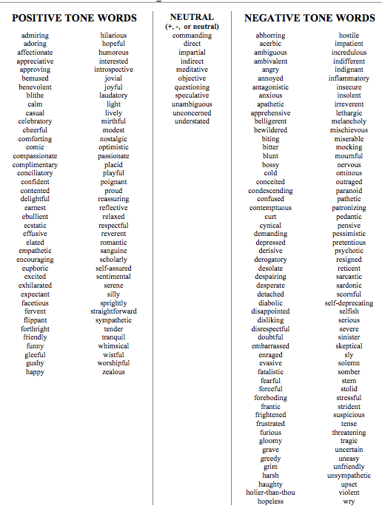
Tone: the attitude a writer takes toward the subject of a work
TONE TOOL:
Use this to help you identify specific tone of a text.
Step 1: Is it neutral, positive, or negative?
Step 2: Go through the list and find appropriate and specific word.
Let’s practice…

Slide 9
TERMS: LOOK IT UP!
PARTNER A: CHARACTERIZATION
PARTNER B: CHARACTER TRAITS

Slide 10
As you read… 2nd read
Underline phrases which help you answer the following:
What is the author’s purpose in writing this story? In other words, what is she trying to accomplish?
What is THEME is communicated?
How does she use CHARACTERIZATION to accomplish purpose and communicate his theme?

Slide 11
THIRD read: MARGINALIA
Explain your annotations along the margins:
* Identify and Summarize Main Ideas: i.e. This explains that___.
✔ Evidence used to support argument:
i.e. This demonstrates/ illustrates/conveys.
? Clarify questions and confusion:
i.e. I don’t understand ____. What does ___ mean? I wonder why____.

Slide 12
After your 2nd read…
What is the author’s purpose in writing this text? In other words, what is she trying to accomplish?
What is the works’ theme?
Simple:
The text reveals that ____________.
Sufficient:
According to ______, ____________.
Sophisticated:
In the essay, “________,” _____ asserts/ proposes/ claims _______________.

Slide 13
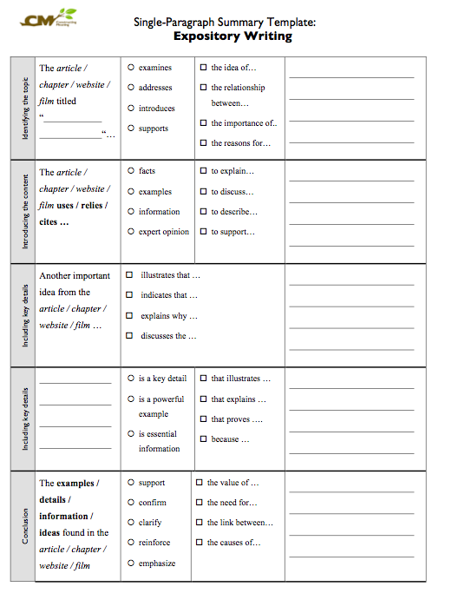
COMPLETE SUMMARY TEMPLATE SUMMARIZE NARRATIVE’s MAIN IDEAS

