Slide 1
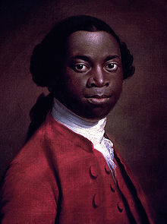
From The Interesting Narrative of the Life of Olaudah Equiano
By Olaudah Equiano

Slide 2
In this lesson series
OBJECTIVE: By practicing CLOSE READING strategies, SWBAT identify Olaudah Equiano’s use of IMAGERY, FIGURATIVE LANGUAGE, and rhetorical triangle in “The Interesting Life of Olaudah Equiano” to persuade readers’ against the slave trade.
Evidence of your learning will be shown through:
Annotations and Marginalia
Dialectical journal and summary.
Progress Check

Slide 3
Autobiographies: Slave Narratives
Document slave life primarily in the American South from the invaluable perspective of first-hand experience.
Reveal the struggles of people of color in the North, as fugitives from the South recorded the disparities between America's ideal of freedom and the reality of racism in the so-called "free states.”
PURPOSE: The most influential slave narratives were designed to educate white readers about both the realities of slavery as an institution and persuade them to join the Abolitionist movement and see black people as individuals deserving of full human rights.

Slide 4
After you watch preview video, use circle map info to write background paragraph.
Use the following paragraph frame:
_______can be described as ______. He was born
________ and spent most of his life________. While ________, he became interested in ________.
Additionally, ________________. His writing attempts to ______________ by _______________.
As you watch video, fill in circle map with important information about Edwards background.
Olaudah Equiano
Notes:
Have students use circle map to write a paragraph on Jonathan Edwards.

Slide 5
Tone: the attitude a writer takes toward the subject of a work
Objective (Informational) v. Subjective (Emotional)
Tone is dependent on diction (word choice) and style.

Slide 6
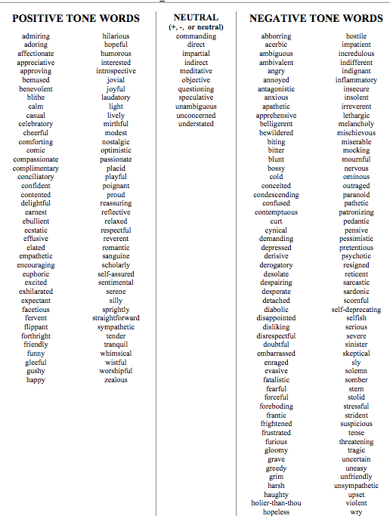
TONE TOOL:
Use this to help you identify specific tone of a text.
Step 1: Is it neutral, positive, or negative?
Step 2: Go through the list and find appropriate and specific word.
Let’s practice…

Slide 7
First read…
Write essential question at top margin of page:
What is the author’s purpose and claim about the topic?
Number the Paragraphs.
Look at the title and use your background knowledge to predict what author will be arguing in this essay.
Quick-Read: 3 minutes
Skim through the article and circle KEY words that convey TONE and seem important to purpose and what he will be arguing.
What is the author’s tone? What word choices does he make to communicate the appropriate tone?

Slide 8
Second: ANNOTATE
Read TWO PARAGRAPHS AT A TIME. Pause between them to do the following:
Underline sentences that help you understand the author’s argument and purpose. Use the following questions to guide your annotations.
What is the author’s argument? Purpose?
How does the author use IMAGERY & FIGURATIVE LANGUAGE to support his argument and accomplish his purpose?

Slide 9
Third read: MARGINALIA
Explain your annotations:
* Identify and Summarize Main Ideas:
i.e. This explains that___.
✔ Evidence or imagery used to support argument:
i.e. This demonstrates/ illustrates/conveys.
? Clarify questions and confusion:
i.e. I don’t understand ____. What does ___ mean? I wonder why____.

Slide 10
After you read…Sum it up
What is the author’s purpose in writing this text? In other words, what is he trying to accomplish?
What is his central claim or argument?
Simple:
The text argues that ____________ _______because______.
Sufficient:
According to ______, ____________.
Sophisticated:
In the text , “________,” _____ asserts/ proposes/ claims _______________.

Slide 11
After you read…
COMPARE the treatment Equiano receives during his enslavement in Africa with the treatment he receives on the slave ship by analyzing PERSUASIVE IMAGERY.
Simple:
The imagery is ________when he is first enslaved in Africa, and changes to ________ after he is sold to European slave traders.
Sufficient:
When he describes __________ the imagery is ________. On the other hand, while _______________.
Sophisticated:
Initially, ____________________; however, upon turn of events which begin when _____________, the _______ conveys ____________.

Slide 12
What is Rhetoric
Rhetorical Transaction

Slide 13
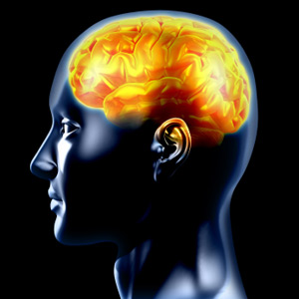
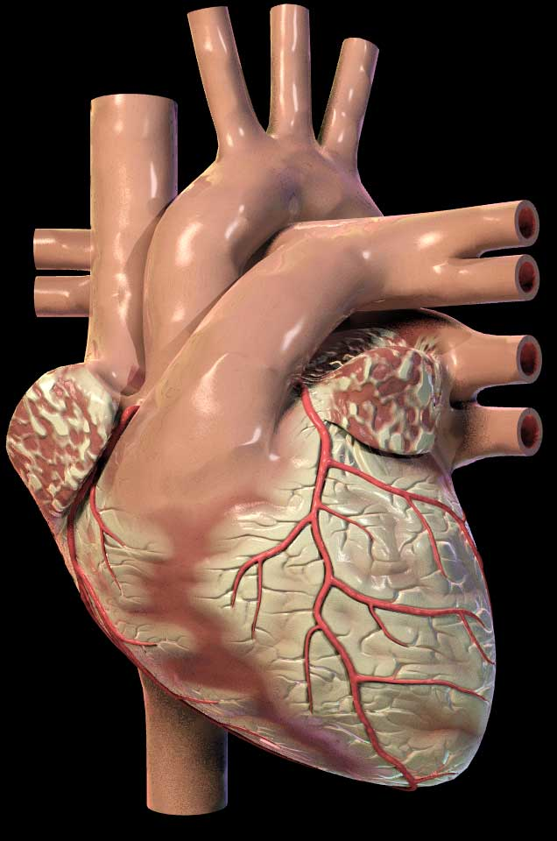
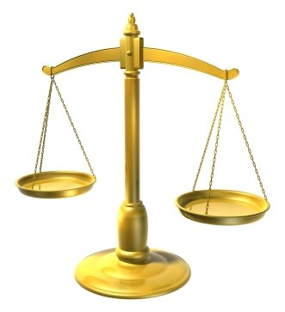
Rhetorical Devices or Persuasive Strategies
LOGICAL APPEALS
a.k.a. LOGOS
EMOTIONAL APPEALS
a.k.a. PATHOS
ETHICAL APPEALS
a.k.a. ETHOS
Using facts and logic to convince audience.
Using emotions to convince the audience.
Establish credibility and appeal to your readers’ ethics and/or moral values.
For example:
A snickers bar is 280 calories. 4 out 5 doctors agree that eating one daily is not very healthy.
For example:
Your donation will help this puppy find a safe loving home and have a chance at a bright future.
For example:
Believe me, I have been through your struggle and I know what it is like to be unemployed.

Slide 14
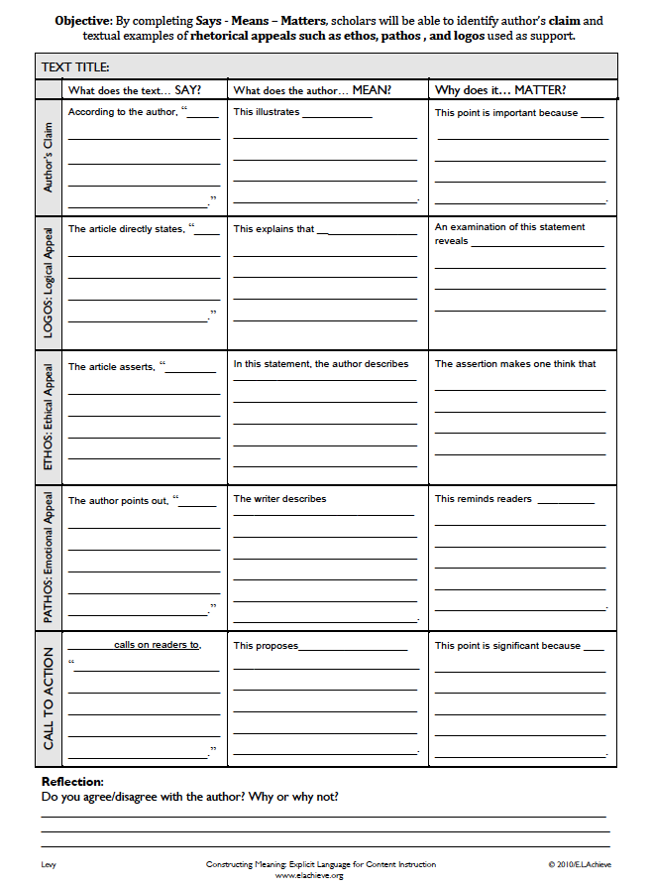
Says-Means-Matters to show that you can cite and analyze and comment on Olaudah Equiano’s use of the Rhetorical Triangle to persuade his audience against the institution of slavery.

Slide 15
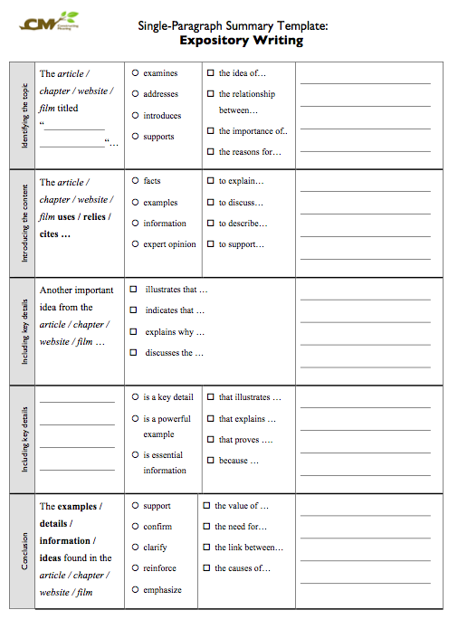
H.W. Summary Template to identify main idea and key details.

