Slide 1
Coming to America: Post-Reading Philosophical Chairs

Slide 2
Today’s Objective
Unit Goal
In a TIMED WRITE ESSAY, SWBAT analyze various texts to develop an argument about how immigration changed America and the lives of those who settled here.
By reflecting and discussing Richard Rodriguez’s “Blaxicans and other Reinvented Americans” students will be able to analyze author’s claim and use of IRONY and ANECDOTE as support.

Slide 3
AGENDA:
First, I will introduce the statements for discussion and students will set Mastery Level Goals.
Then, we will participate in Philosophical Chairs.
Finally, you will reflect and evaluate the discussion.

Slide 4
Philosophical Chairs
Directions: Read the following statements and rate your level of agreement from AGREE TO DISAGREE.
Prepare to discuss you answer by writing a brief explanation of your opinion on the lines which follow.

Slide 5
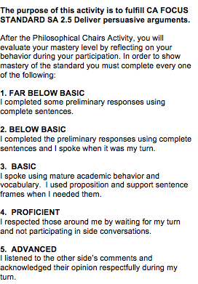
Before we begin: Circle your Mastery Target

Slide 6
AGREE
DISAGREE
Immigrants threaten American sense of identity.

Slide 7
AGREE
DISAGREE
American discussion on race are usually two sided and exclude other points of view.

Slide 8
AGREE
DISAGREE
People in the United States would get along better if we adopted a model that promotes “mixture” such as that of colonial Mexico.

Slide 9
AGREE
DISAGREE
American society should discourage racial/ ethnic identification and instead encourage immigrants to ASSIMILATE American culture as soon as possible.

Slide 10
AGREE
DISAGREE
Immigrants are an essential component of American identity and tradition.

Slide 11
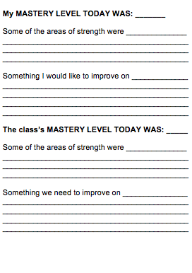
After Discussion: Identify the Mastery Level Accomplished

Slide 12
Whip Around
I liked when _______ said __________ because _______________.
An interesting idea _______________
Something I learned from the discussion ______________________.
I still don’t understand _____________.
Notes:
12

