Slide 1
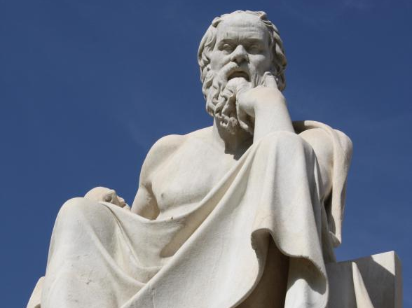
By participating in
Socratic Seminar
Scholars will practice academic behavior and language that
will be expected in a 21st century classroom & worksplace.

Slide 2
Socratic Seminar
COLLECTION CONCEPT:
THE PURPOSE OF EDUCATION
OBJECTIVE: SWBAT 1.) Prepare for Socratic Seminar discussion of views of the purpose of EDUCATION.
2.) Gain a deeper understanding of MULTIPLE PERSPECTIVES on the PURPOSE OF EDUCATION.

Slide 3
What is a Socratic Seminar?
Socratic seminar is a method of teaching developed by Socrates. He engaged his students in intellectual discussion by responding to questions with questions, instead of answers. This method encouraged the students to think for themselves rather than being told what to think.

Slide 4
By participating in a Socratic Seminar you will practice academic behavior that will be expected in college and/or the workplace environment. This behavior includes: LISTENING, ASKING, AND DISCUSSING

Slide 5
YOU SHOW ACADEMIC BEHAVIOR by
a. Participating when it is your turn to speak.
b. Expressing yourself clearly in sophisticated language.
c. Respecting others by avoiding side conversation and rude behaviors such as negative body language.
d. Speaking when it only when it is your turn and not interrupting or cutting someone off.
e. Making logical comments that are related to the text and purpose being discussed.

Slide 6
First read…ANNOTATIONS
Number the Paragraphs.
Underline the title and use it along with your background knowledge to predict what author will be arguing in this text.
Quick-Read: 3 minutes
Skim through the article and circle KEY words that seem to be important to what he will be arguing or communicating.

Slide 7
SECOND READ: Explain your annotations with MARGINALIA
* Identify and Summarize Main Ideas: i.e. This explains that___.
✔ Evidence used to support argument:
i.e. This demonstrates/ illustrates/conveys… ETHOS, PATHOS, LOGOS
? Clarify questions and confusion:
i.e. I don’t understand ____. What does ___ mean? I wonder why____.
! Identify CALL TO ACTION

Slide 8
After your 2nd read…
What is the author’s PURPOSE and CENTRAL CLAIM or argument?
Simple:
The texts argues that ____________ _______because______.
Sufficient:
According to ______, ____________.
Sophisticated:
In the text, “________,” _____ asserts/ proposes/ claims _______________.

Slide 9
Part 1: Prepare & Generate Questions Using Texts & Academic Terms
THIKERS/ TEXTS
Martin Luther King, Jr. on the purpose of Education
IDEAS
Education
LITERARY/ RHETORICAL Devices
Claim/ Argument
Francisco Goya, “The Sleep of Reason Produces Monsters”
Rainsfod Stauffer, “Dropping Out of College and Into Life”
“Classrooms Around the World” by Valerie Strauss
“Allegory of the Cave” by Plato
Hsun Tzu, “Encouraging Learning”
Economic
Evidence
Allegory
Tone
Anecdote
Imagery
“The Purpose of Education” by Mr. Osborne
“Education for Profit, Education for Democracy” by Martha Nussbaum
“Dropping Out of College and Into Life” by Eduardo Porter
Purpose
Reliability
Credibility
Commentary
Counterargument
Call to Action
Analogy
Case Study

Slide 10
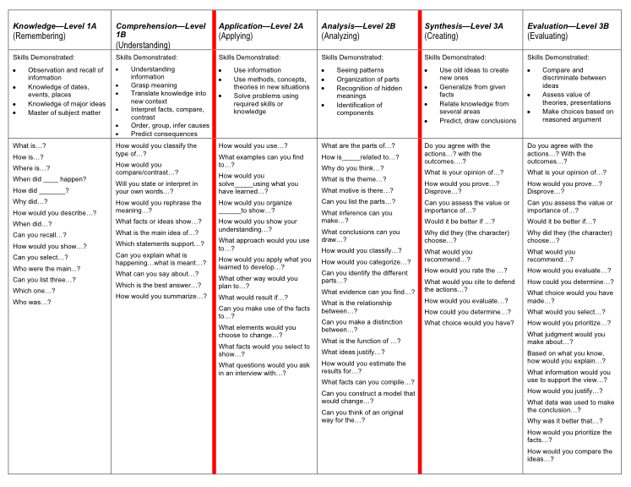

Slide 11
I DO: Directions for Socratic Seminar

Slide 12
Students in the Inner-Circle
Students will take notes on the right side of their Cornell Notes
These notes can relate to the questions they created and/or their notes should reflect the critical points made by peers in the discussion.
Students can continue to generate questions and/or copy down questions of their fellow scholars to address.
Students in the Outer-Circle
Students will evaluate the participation of their A/B partner.
Students will meet and debrief with their A/B partner after the conclusion of the seminar.

Slide 13
INNER CIRCLE: YOU SHOW ACADEMIC BEHAVIOR by
Contributing to discussion at least three times with questions, comments, or opinions. [ ] YES
Expressing themselves clearly in sophisticated academic language. [ ] YES
Respecting others by avoiding side conversation and rude behaviors. [ ] YES
Speaking only when it is their turn and bringing others into the conversation without interrupting or cutting someone off. . [ ] YES
Making logical comments that are related to the topic and issue being discussed and are backed up though evidence from the text. . [ ] YES

Slide 14
OUTER CIRCLE
Respecting others by avoiding side conversation and rude behaviors. [ ] YES
Turning in the Socratic Seminar Notes form COMPLETED with at least three questions, notes, and comments. [ ] YES
Evaluating your partner’s participation by completing Socratic Seminar Observation form . [ ] YES
Completing Seminar Evaluation FINAL THOUGHTS. [ ] YES
Participating in the conversation by taking the “Hot Seat.” [ ] YES

Slide 15
WRAP UP-Whip around
SCORE
I liked when _______ said __________ because _______________.
An interesting idea _______________
Something I learned from the discussion ______________________.
ROOM FOR IMPROVEMENT
I still don’t understand _____________.
IN THE NEXT SOCRATIC SEMINAR…

Slide 16
PART THREE
By answering the following ESSENTIAL QUESTIONS:
TOPIC SENTENCE: What did you learn about American literature, culture, and thought by through this discussion?
INTRODUCE EVIDENCE: What idea(s) did these writers communicate which helped you understand American literature and culture better?
EVIDENCE: Which assignments in your portfolio provide the best examples of this understanding? Be specific by pointing out details in your work.
ANALYSIS: What do these details show about what you learned, where you stand in your development as a scholar, or the connections you made to the content?
COMMENTARY: What did you enjoy the MOST about this unit: the reading? the analysis as a class through discussion? writing the analyses? or writing the poems? WHY? Which text did you feel you connected with most? Why?

