Slide 1
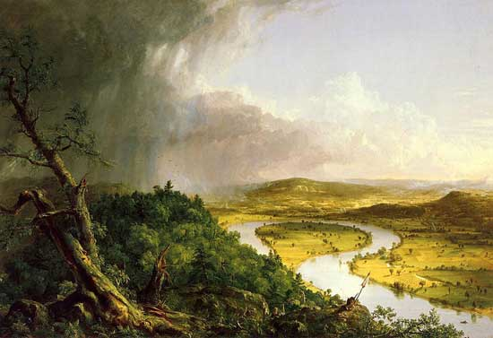
American Romanticism 1800-1860

Slide 2
3P Honors: Unit Goal
Write an essay that defines American Romanticism and COMPARES the philosophical values and aesthetic features of Transcendentalists and Dark Romantics.
Pre-Reading: Concept Attainment, Give One Get One, Graffiti Wall
Reading: Ralph Waldo Emerson, Henry David Thoreau, Edgar Allan Poe, Nathaniel Hawthorne
Post-Reading: Philosophical Chairs/Socratic Seminar, World Café, Summative Essay

Slide 3
American Romanticism
Objective--
After concept attainment activity, scavenger hunt on philosophical movements, and an analysis of quotes by German philosopher Immanuel Kant, students will be able to define American Romanticism by writing a summarizing paragraph.

Slide 4
Belongs or Doesn’t
You will be shown a series of pictures.
The pictures will depict relationships.
Determine which belong and which do not.

Slide 5
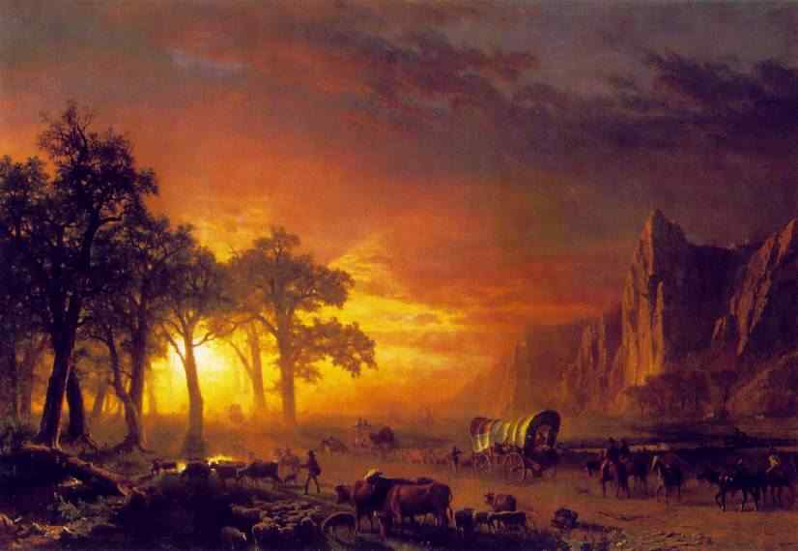
This belongs...

Slide 6
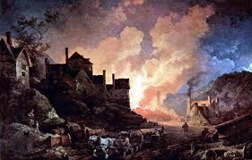
This doesn’t...

Slide 7
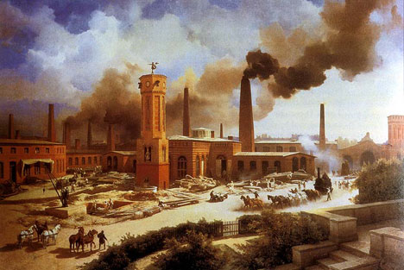
This doesn’t...

Slide 8
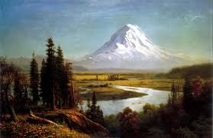
This belongs...

Slide 9
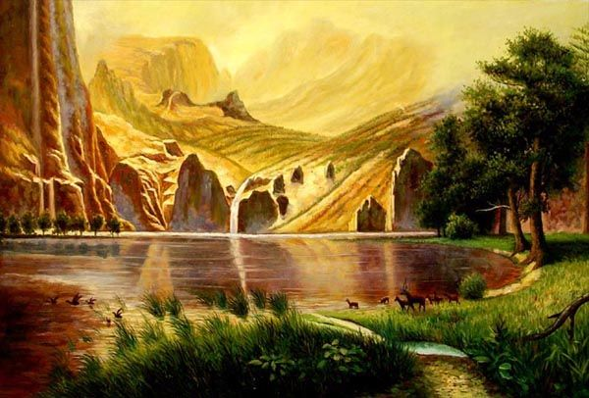
This belongs...

Slide 10
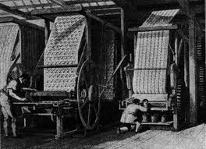
This doesn’t...

Slide 11
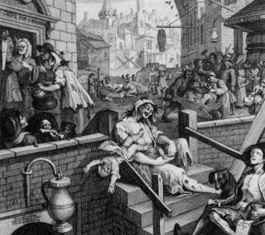
This doesn’t...

Slide 12
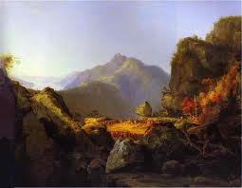
This belongs...

Slide 13
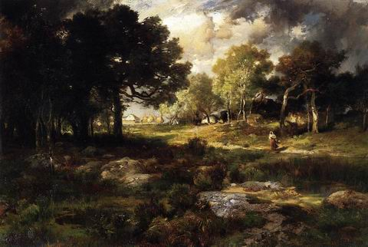
This belongs...

Slide 14
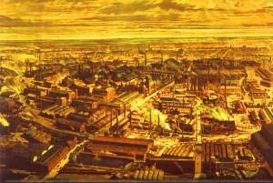
This doesn’t...

Slide 15
What belongs? What doesn’t? Based on the images, describe Romanticism. American Romanticism values _______________ and it is a reaction against___________.

Slide 16
Define American Romanticism
Romanticism (or the Romantic Era) was a complex artistic, literary, and philosophical movement that started in the second half of the 18th century in Europe, and gained strength in the Americas as a reaction against Rationalism and the Industrial Revolution

Slide 17
SCAVENGER HUNT
WITH PARTNERS FIND DEFINITIONS :
Philosophy
Movement
5 MINUTES

Slide 18
Give One Get One
What is the Romantic view of knowledge?
1. Share your quote and insight with at least three peers.
2. Collect three ideas from peers write them down .
3. After every conversation, have your peer sign their name.
4. At the end of the activity, give props to peers’ ideas!
Question:
My ideas:
According to_____, “_________.” The statement reveals that________.
My peers ideas:
1.
2.
3.

Slide 19
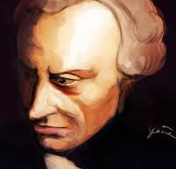
Immanuel Kant, from Critique of Pure Reason
What is the Romantic view of knowledge?
“All our knowledge begins with the senses, proceeds then to the understanding, and ends with reason. There is nothing higher than reason.”
“It is beyond a doubt that all our knowledge begins with experience.”
“Immaturity is the incapacity to use intelligence without the guidance of another. “
Choose a quote. Explain what you think it means and what it reveals about knowledge

Slide 20
According to American Romanticism TRUTH IS SUBJECTIVE, and dependent on individual experience:
Celebrates truth as unspoiled nature above from artificiality and corruption of society, technology & industrialization.
2. Truth can best be found through individual experience and contemplation away from society’s corrupting influence.
Truth can be found in feelings, imagination, and intuition over reason & science.
4. Truth is best understood through the wisdom of youthful, naïve innocence above educated sophistication.

Slide 21
Romanticism
TRANSCENDENTALISTS
“I am nothing. I see all.”
DARK ROMANTICS
“Nevermore.”

Slide 22
Can you define American Romanticism?
TOPIC SENTENCE: What is American Romanticism?
INTRODUCTION TO EVIDENCE: What historical conditions was it reacting against? What does Romanticism value?
EVIDENCE: Use a quote by Immanuel Kant to reveal Romantic ideals.
ANALYSIS: What ideas and values does Kant reveal about Romanticism as a philosophical movement?
COMMENTARY: Do you agree with it? Why or why not?

Slide 23
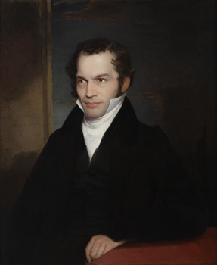
Can you identify features of Romanticism in William Cullen Bryant’s poem “Thanatopsis”?

Slide 24
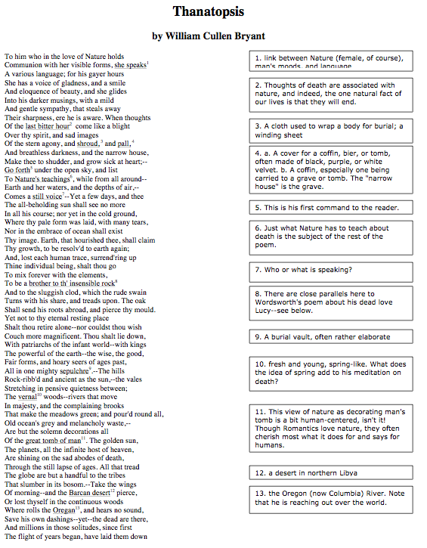
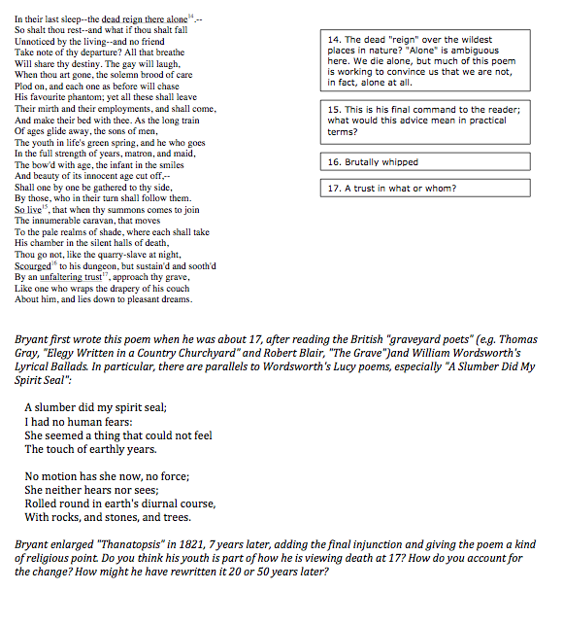

Slide 25
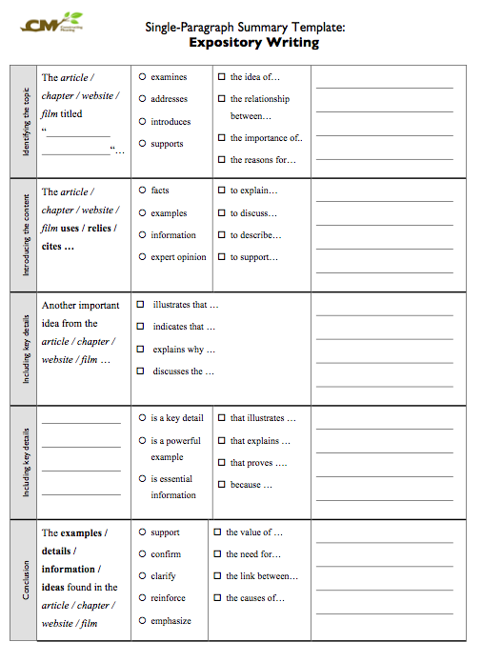
Summary Template to identify main idea and key details of “Thanatopsis”

