Slide 1
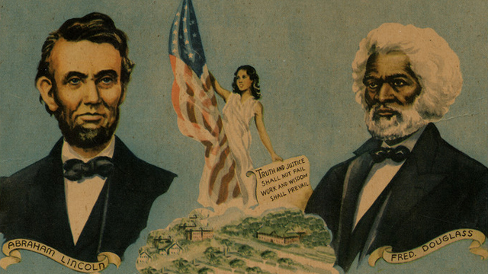
The New Birth of Freedom

Slide 2
The New Birth of Freedom
After CLOSE READING Abraham Lincoln’s “Second Inaugural Address” and Frederick Douglass’s “What to the Slave is the Fourth of July,” students will evaluate how the author uses ethos, pathos, and/or logos to communicate and support ideas and IMPLEMENT these strategies in SPEECHES.
Evidence:
Annotations and Marginalia
Comparative Summary
Socratic Seminar (Progress Check 1)
Photo Essays (Progress Check 2)
SPEECHES (Summative Project)

Slide 3
After watching biographical video clip, students will be able to describe the author’s background and explain influence of historical context on his writing and philosophical stance.
Use the following paragraph frame:
_______can be described as ______. He was born________ and spent most of his life________. While ________, he became interested in ________.
Additionally, ________________. According to_________, in the video, article, essay titled “____________,”_____________. Other influences on his work and philosophical stance include
____________________. His writing attempts to ______________ by _______________.
Fill in circle map with important information about the author’s background.
AUTHOR
Notes:
Have students use circle map to write a paragraph on Jonathan Edwards.

Slide 4
Before you read… 1st read
Number the Paragraphs.
Look at the title and use your background knowledge to predict what the text will be about and the theme which will be communicated.
Quick-Read: 3 minutes
Skim through the article and circle KEY words that seem to be important to what he will be arguing or communicating.

Slide 5
THIRD read: MARGINALIA
Explain your annotations along the margins:
* Identify and Summarize Main Ideas: i.e. This explains that___.
✔ Evidence/Appeals used to support argument:
i.e. This demonstrates/ illustrates/conveys.
? Clarify questions and confusion:
i.e. I don’t understand ____. What does ___ mean? I wonder why____.

Slide 6
After your 3rd read…
What is the author’s purpose in writing this text? In other words, what is he trying to accomplish?
What is his central claim or argument and what is its relevance to our COLLECTION TOPIC?
Simple:
The text reveals that ____________.
Sufficient:
According to ______, ____________.
Sophisticated:
In the __________, “________,” _____ asserts/ proposes/ claims _______________.

Slide 7
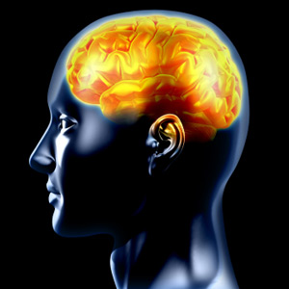
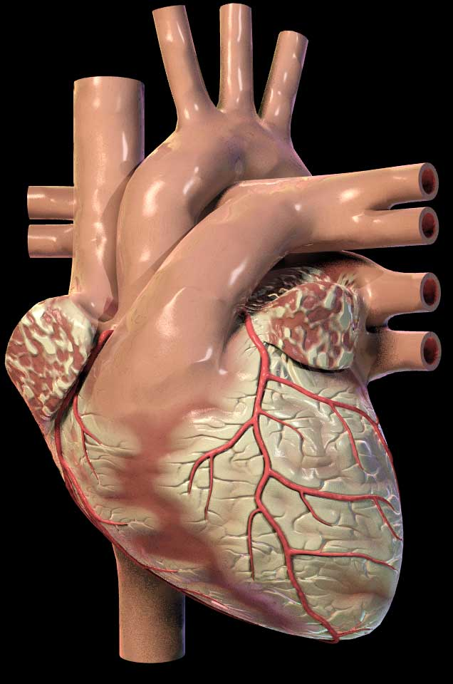
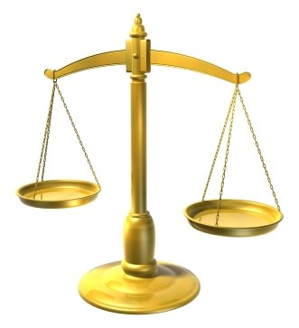
Rhetorical Devices or Persuasive Strategies
LOGICAL APPEALS
a.k.a. LOGOS
EMOTIONAL APPEALS
a.k.a. PATHOS
ETHICAL APPEALS
a.k.a. ETHOS
Using facts and logic to convince audience.
Using emotions to convince the audience.
Establish credibility and appeal to your readers’ ethics and/or moral values.
For example:
A snickers bar is 280 calories. 4 out 5 doctors agree that eating one daily is not very healthy.
For example:
Your donation will help this puppy find a safe loving home and have a chance at a bright future.
For example:
Believe me, I have been through your struggle and I know what it is like to be unemployed.

