Slide 1
The Awakening
By Kate Chopin

Slide 2
Reading Focus:
Identify how Kate Chopin incorporates features of REALISM in the plot of The Awakening by analyzing ARCHETYPAL characters, SYMBOLISM of setting, and the resolution of conflict.
Evidence:
Reading Checks
Chapter Summaries
Literary Circles & Socratic Seminar Discussion
Progress Checks

Slide 3
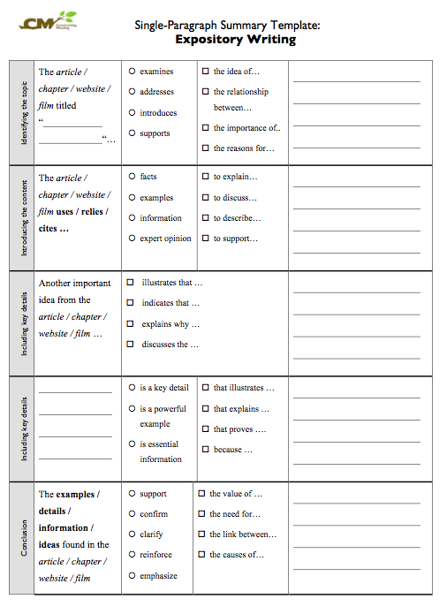
Use Summary Template to identify main idea and key details.

Slide 4
Literary Circles
Small groups of students gather together to discuss a piece of literature in depth.
The discussion is guided by students' response to what they have read.
They provide a way for students to engage in critical thinking and reflection as they read, discuss, and respond to books.

Slide 5
Literary Circles
NATURALISM
DETERMINISM: Inspired by Darwin’s theory of Evolution. In Naturalist literature, characters are like all other animals posessed by instinct to survive in environments that serve as adversarial forces. Look for the effect of setting, and external forces on plot.
OBJECTIVISM:
Influenced by BF Skinners’s beliefs that character is most influenced by the environment. Look for Characters conditioned by environment and described in detailed yet detached journalistic/ scientific style.
PESSIMISM: Topics covered by literature deals with the underbelly of society. These include realistic treatment of taboo subjects that might include criminality, sexuality, poverty and racism. FIND Heavy Foreshadowing that develops a sense of impending doom.
INDIFFERENT UNIVERSE: The same nature that Emerson idealized is indifferent in the face of human suffering and struggle. Look for this idea through author’s use of IRONY and SYMBOLS.

Slide 6
Essential Questions
Chapter I-X: How does Kate Chopin Naturalist ideas and features in the novel’s exposition which takes place in Grand Isle?
Chapter XI- XXII: Can you explain how Kate Chopin uses figurative language and symbolism to reveal emerging conflicts and themes in the story in the Esplanade Street Chapters?
Chapter XXIII-XXXIII: How does Chopin use Psychological Realism through Edna’s character in the Pigeon House Chapters? What Naturalist ideas are conveyed through the characters’ internal life and conflicts?
Chapter XXXIII-XXXIX: What philosophical ideas are communicated by the novel’s resolution? Can it be argued that this is a FEMINIST text?

Slide 7
Socratic Seminar #1
OBJECTIVES:
Scholars will explore REALIST IDEALS AND AESTHETIC FEATURES with a focus on the purpose of calling attention to social changes as they are exhibited in Collection 5 texts.
Additionally, students will evaluate the influence of these texts’ ideas on contemporary American culture and society.
ESSENTIAL QUESTIONS:
What are the REALIST’s views of the purpose of literature in society?
How does Chopin introduce REALIST IDEALS & FEATURES in the exposition of her novel, The Awakening?
Chapter I-XXII: How does setting begin to show signs of REALIST symbolism?

Slide 8
Socratic Seminar #2
OBJECTIVES:
Scholars will explore REALIST IDEALS AND AESTHETIC FEATURES with a focus on the purpose of calling attention to social changes as they are exhibited in Collection 5 texts.
Additionally, students will evaluate the influence of these texts’ ideas on contemporary American culture and society.
ESSENTIAL QUESTIONS:
What are the REALIST’s views of the purpose of literature in society?
How does Chopin introduce REALIST IDEALS & FEATURES in the RESOLUTION of her novel, The Awakening?
THEME: Do you agree with Barbara Kingsolver’s essay? Is Edna’s end a feminist statement?

