Slide 1
American Modernism: Historical Context
Objective: Identify the historical context of American Modernism and explain its effects on American thought, culture.
AGENDA:
Quick Analysis: “A Dream Deferred” by Langston Hughes
Historical Context of American Modernism
Definition of American Modernism
3-2-1 CHECK IN

Slide 2
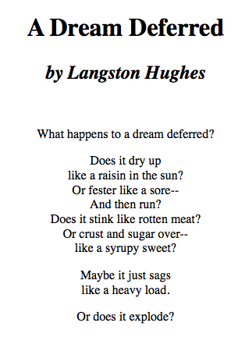
Bell Work – Poem Analysis
Other people’s ideas can help us understand the world better.
READ the poem 1 minute SILENTLY.
2. Explain the IMAGERY to your partner using the sentence frame:
A.DESCRIBE: ______is showing____
B. EXPLAIN: Through these images I believe the poem is saying…
Using the sentence frames below, write an analysis of the text.
In this poem about________________, _______’s perspective is that the AMERICAN DREAM IS _________. This means that _____________, which is relevant to ___________________________because ________________________________.
Get up, read your analysis to two people, and sit back down.

Slide 3
The American Dream as LITERARY TROPE
A LITERARY TROPE is a recurring image or figure of speech in literature. The American Dream is the repeated allegory that includes:
America as the New Eden: A land of beauty, bounty, and unlimited promise.
A belief in unlimited progress: life keeps getting better and we are always moving toward greater prosperity, justice and happiness.
Triumph of the individual: the independent, self-reliant person as the IDEAL American.
Notes:
3

Slide 4
Disillusion with the American Dream as MODERNIST THEME

Slide 5
FINALLY,
THEN,
FIRST,
How did Modernists view the American Dream?
Modernism
A cultural and social movement that was caused by disillusionment with traditions. Modernism called for bold experimentation in style, subject matter, and attitude. Artists aimed to rid art of 19th Century Sentimentality and “prettiness.”
Why would there be a rise in Marxism and interest in the psychoanalysis or the inner workings of the mind?
1920’s
How did Jazz and the Harlem Renaissance breakdown gender roles and racial barriers?
Why was the traditional “Hero” no longer an believable character in literature?
Describe the historical context which inspired American Modernism &
Its disillusion with the American Dream.
Define American Modernism and identify its aesthetic& philosophical features.
Identify the effects of Modernism on American culture.

Slide 6
Essential Questions: What was the historical context of American Modernism? Why would the historical context cause a feeling of disillusion with the American Dream.
WAR
Civil Rights
Organized
Crime
1920’s
New Technology

Slide 7
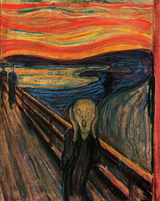
Define American Modernism
A cultural and social movement that was caused by disillusion with traditions that reached its height between 1914-1939.
Modernism call ed for bold experimentation in style, subject matter, and attitude.
Artists aimed to rid art of 19th Century Sentimentality and “prettiness.”
How did the historical context cause the disillusion which marks Modernism.
“The Scream” by Edward Munch, 1893

Slide 8
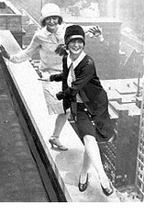
Subversion of Social Norms & Traditions
Subversion: is rebel, overthrow, or undermine something.
Modernist plots explore the implication of subversion taking place at the time including:
* New Gender Roles: Women were given the right to vote in 1920. Hemlines raised; Margaret Sanger introduces the idea of birth control.
New Economic Models: Karl Marx’s ideas flourish; the Bolshevik Revolution overthrows Russia’s czarist government and establishes the Soviet Union.
Blurring of Racial Lines and Boundaries.

Slide 9
Valorization of the Antihero
An Antihero is an ARCHETYPAL character that is morally ambiguous and lacks heroic qualities.
Antihero is the valorized or favored Modernist protagonist and archetype.
The archetypal antihero demonstrates the moral uncertainty felt by individuals living in this era.

Slide 10
Individual Alienation
Alienation: the feeling of being turned away or rejected.
Sense of alienation in literature:
_ Focus on the internal feeling of not belonging or turned away from tradition and community.
- The antihero suffers from psychological a “dissociation of sensibility”—separation and fracturing of thought from feeling (T. S. Eliot)
Fragmented sense of self is revealed by using experimental techniques that include stream and consciousness.

Slide 11
3-2-1 Check In
3 things you learned about Modernism and its historical context.
2 things you want to learn more about.
1 question about what we learned today.

Slide 12
Can you define American Modernism and describe its historical context?
MY IDEAS:
Modernism can be defined as _______.
Its attitude __________________. It was a result of ___________________. During this time, ___________________. As a result. Features of __________ include ________, _______, _________ and ____________.

Slide 13
SET YOUR CLOCK APPOINTMENTS

Slide 14
Can you define American Modernism and describe its historical context?
12 0’CLOCK
________________SAYS____________________.
3 0’CLOCK
ACCORDING TO ___________________________
6 0’CLOCK
_____________ BELIEVES____________________.

Slide 15
AFTER WATCHING DOCMENTARY, DESCRIBE F. SCOTT FITZGERALD’S BACKGROUND,
LITERARY INTERESTS, AND INFLUENCE ON AMERICAN CULTURE by using a circle map as SUPPORT.
F. Scott Fitzgerald

Slide 16
_______can be described as ______. He was born ________ and spent most of his life________. While ________, he became interested in ________. Additionally, ________________. His works attempt to ______________ by _______________.

