Slide 2
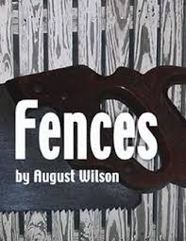
Unit Goal
Students will write a response essays that examines author’s use of SYMBOLS to reveal a.) the conflicts caused by expectations in family relationships b.) the flaws of the 20th Century tragic hero c.) the impact of larger political forces on private lives.

Slide 3
After you conduct your research, use circle map info to prepare to write a background paragraph.
Use the following paragraph frame:
_______can be described as ______. He was born
________ and spent most of his life________. While ________, he became interested in ________.
Additionally, ________________. His writing attempts to ______________ by _______________.
As you watch video, fill in circle map with important information about author’s background.
TOPIC or SUBJECT

Slide 4
ESSENTIAL QUESTIONS
How do family relationships and expectations shape our identity and motivate our plans for the future?
To what degree are family conflicts caused by unrealistic expectations?
Do individuals have any responsibilities to the dreams created by those who supported/ raised them? (family members or otherwise)
Are most people destined to make the same mistakes as their parents?

Slide 5
What does the script reveal about the SYMBOLISM of the family members?
EVENT/ QUOTE:
What happens? Who does it happen to?
Analysis: WHY DOES IT HAPPEN? WHY IT IS IMPORTANT?
The dialogue shows, _____________.
This event reveals_______________________.
The statement makes clear,___________.
The character demonstrates___________________________.
This comment suggests_______________________________.
The character’s behavior is evidence that________.

Slide 6
Give One Get One
1. Use the OBJECTIVE to write your question. Answer your question.
2. Collect three ideas from peers write them down .
3. After every conversation, have your peer sign their name.
4. At the end of the activity, give props to peers’ ideas!
Question: Are FENCES a symbol of optimism or pessimism? Why?
My ideas:
My peers ideas:
1.
2.
3.

Slide 7
Whip Around
I liked when _______ said __________ because _______________.
An interesting idea _______________
Something I learned from the discussion ______________________.
I still don’t understand _____________.
Notes:
7

Slide 8
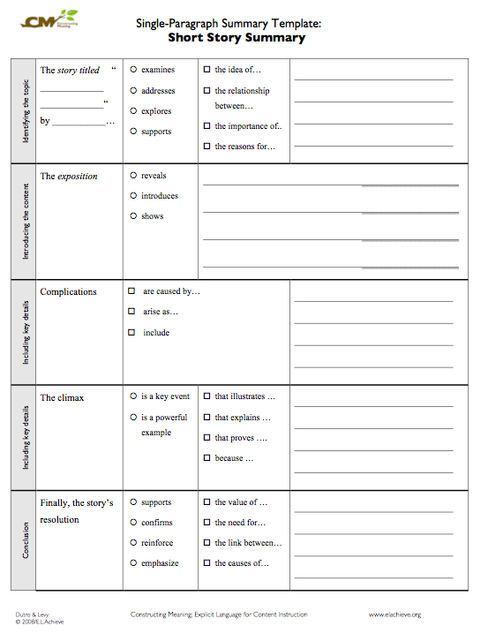
Summary Template to identify main idea and key events in the play’s plot.

