Slide 1
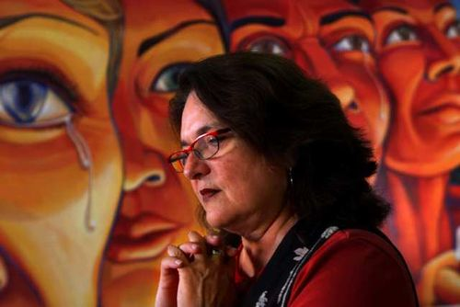
“The World Wall” by Judy Baca

Slide 2
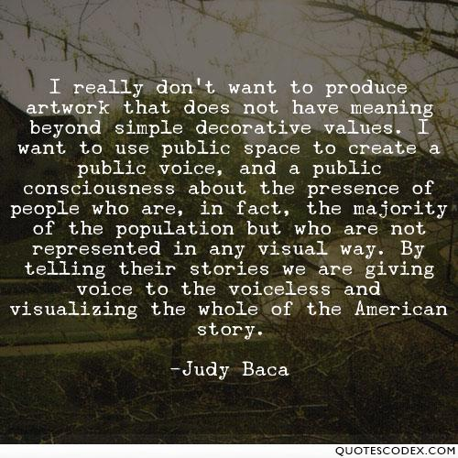

Slide 3
Gather your materials
LOOK!
Instructions: Look at the pieces of art provided. Choose one that catches your eye.
Stanza 1: Tell a story about what may be going on in the picture. “Who is doing what, and why?”
Stanza 2: Describe the imagery in the picture. Include sight, sound, touch, taste, and smell.
Stanza 3: What does the picture make you feel and think about?

Slide 4
Baca, Judy. “Balance.” World Wall: A Vision of the Future Without Fear. SPARCinLA. 11 June, 2018. web
http://sparcinla.org/balance-panel/

Slide 5
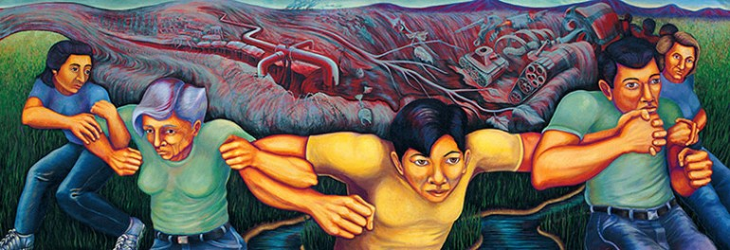
Baca, Judy. “NonViolence is Our Strength.” World Wall: A Vision of the Future Without Fear. SPARCinLA. 11 June, 2018. web
http://sparcinla.org/non-violent-resistance/

Slide 6
Baca, Judy. “Triumph of the Hands.” World Wall: A Vision of the Future Without Fear. SPARCinLA. 11 June, 2018. web
http://sparcinla.org/triumph-of-the-hands/

Slide 7
Baca, Judy. “Triumph of the Hearts.” World Wall: A Vision of the Future Without Fear. SPARCinLA. 11 June, 2018. web
http://sparcinla.org/triumph-of-the-hearts/

