Slide 1
The Purpose of Education
After CLOSE READING multiple texts, SCHOLARS will be able to compare views of the PURPOSE OF EDUCATION and evaluate how authors use of evidence and rhetorical strategies (i.e.) ethos, pathos, and/or logos to communicate and support and ideas across genres.
Evidence:
Annotations and Marginalia
Summarizing Statements

Slide 2
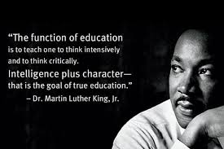

Slide 3
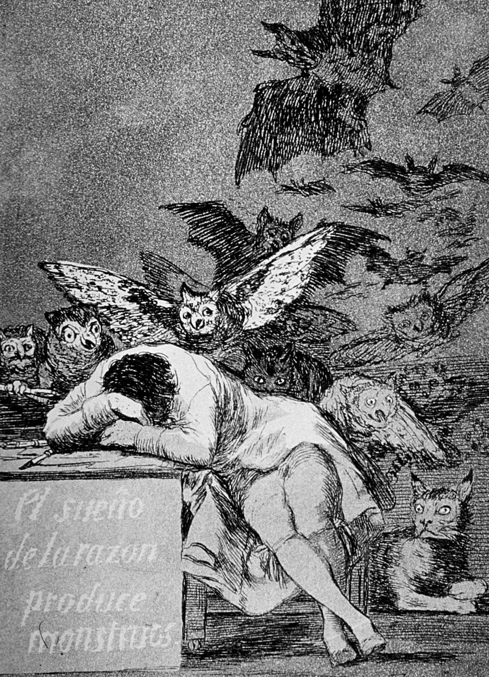
Bell – Image Analysis
“The Sleep of Reason Produces Monsters
OVERVIEW: This image is about REASON. We are using this image to discuss the purpose of EDUCATION.
PARTS: Look at art piece below for 1 minute SILENTLY, LIST all the PARTS that seem important to ideas about POWER.
TITLE: The title is “The Sleep of Reason Produces Monster.” Reason as used in the title is “The power of the mind to think, understand, and form judgment according to a process of logic and rational analysis of facts. How does the title contribute to the meaning?
INTERRELATIONS: This is an analysis of the artistic LINE OF REASONING. How are the parts (COLORS, OBJECTS, COMPOSITION) related and come together to convey an IDEA or ARGUMENT on the purpose of EDUCATION.

Slide 4
Image Analysis
CONCLUSION
Using the sentence frames below, write an analysis of the text.
The central claim illustrated/depicted by the Illustration _______titled________by ______________is that________. Specific details that reveal this claim include_______________, ______, and ____ which represent the idea that ____________.
.
Get up, read your analysis to two people, and sit back down.

Slide 5
Before you read… 1st read
Number the Paragraphs.
Look at the title and use your background knowledge to predict what the text will be about and the theme which will be communicated.
Quick-Read: 3 minutes
Skim through the article and circle KEY words that seem to be important to what he will be arguing or communicating.

Slide 6
MARGINALIA
Explain your annotations along the margins:
* Identify and Summarize Main Ideas: i.e. This explains that___.
✔ Evidence used to support argument:
i.e. This demonstrates/ illustrates/conveys.
? Clarify questions and confusion:
i.e. I don’t understand ____. What does ___ mean? I wonder why____.

Slide 7
After you read…
What is the author’s primary PURPOSE in writing this text? In other words, what is s/he trying to accomplish? To entertain? To persuade? To inform? To describe?
What is their central claim or argument?
Do you dis/agree?
Simple:
The text reveals that ____________. I disagree, ______.
Sufficient:
According to ______, ____________; however, I believe ___.
Sophisticated:
In the __________, “________,” _____ asserts/ proposes/ claims _______________. While I agree that ______, it is important to consider_______.

Slide 8
Give One Get One
1. Use the OBJECTIVE to write your question. Answer your question.
2. Collect three ideas from peers write them down .
3. After every conversation, have your peer sign their name.
4. Most agree that __________; however, some differences ______.
Question: What is the author’s ARGUMENT about the TOPIC? Do you agree? Why?
My ideas:
My peers ideas:
1.
2.
3.
4.

Slide 9
Whip Around
I liked when _______ said __________ because _______________.
An interesting idea _______________
Something I learned from the discussion ______________________.
I still don’t understand _____________.
Notes:
9

Slide 10
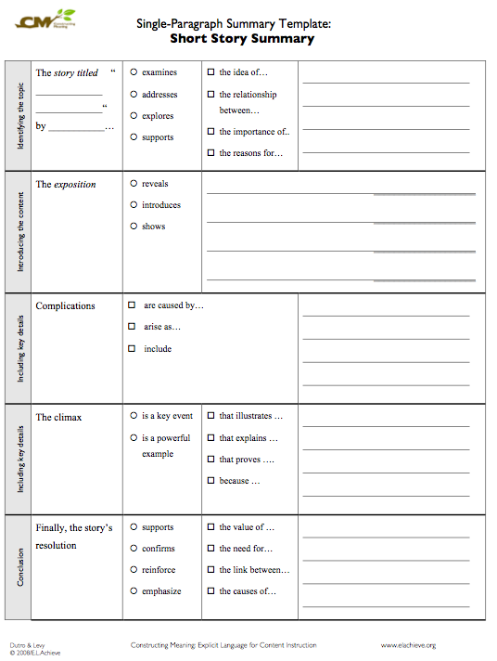
HOMEWORKCOMPLETE SUMMARY TEMPLATE SUMMARIZE TEXT’s MAIN IDEAS

