Slide 2
Evaluator Identification & Preview
Sign your name at the end of the essay.
Review objective of the PROGRESS CHECK.
Take 2 minutes to preview your peers writing and ideas.
Are the ideas easy to follow?
Do spelling and grammar errors take attention away from the ideas?

Slide 3
CONVENTIONS:
SPELLING: Spelling errors must NOT distract reader from ideas. Circle misspelled words. Spell them correctly. Check for commonly misspelled words. For example:
then, than
Effect, affect,
its, it’s
Their, there
To, too, two
MISSING WORDS: Use a carat ^ to insert missing words.
CAPITALIZATION: Beginning of sentences & proper nouns must be Capitalized. Underline letters that should/should not be capitalized twice.
PUNCTUATION: Every sentence must end with a period or question mark. Commas will separate clauses accurately.
FRAGMENTS: No incomplete sentences.
i.e. Wants to show that man is the “lowest” animal. Missing SUBJECT!
Comparing the earl and the anaconda. Missing Predicate.
RUN-ON’s: Look for long sentences that could be broken up into two complete sentences by adding punctuation or separating the clauses with commas.
QUOTATION MARKS will mark the use of citations. For example, “I said that punctuation helps the reader follow the writer’s train of thought” (2).

Slide 4
ACADEMIC LANGUAGE
No CONTRACTIONS: spell out don’t, aren’t, isn’t, etc.
No 2nd Person: Cross out all You’s. Suggest whether the writer should instead use: reader/s, individual/s, one, audience, Americans, etc.
No 1st Person: Cross out all I think/ believe
No PAST TENSE VERBS while analyzing the text. In literary analysis essays, all is happening while they are being read: USE PRESENT TENSE ONLY!
No PASSIVE VOICE: Use active verbs to describe actions of text. For example:
Passive: Twain is arguing that man is the lowest animal.
Active: Twain argues that man is the lowest animal.

Slide 5
ACADEMIC STYLE
Transitions: Do ideas flow with ease?
SYNTACTICAL VARIETY: Do many of the sentences start the same way or is there variety? UNDERLINE the beginning of sentences that should be reworded.
Word Choice: Does the student use a variety of verbs in their analysis or is there lots of repetition? HIGHLIGHT all the times your colleague uses SHOWS or any other VERB repeatedly.
Tone: Is the TONE conversational or formal?

Slide 6
CLARITY & ORGANIZATION
UNDERLINE with with squiggly line areas that are vague and confusing. Red flags for this are sentences with QUESTION WORDS such what, why, how, where when (i.e. This shows how/what the settlers felt.) Suggest how these can be rewritten.
Cross out areas that are repetitive and off topic.
Check for subject verb agreement. Do all verbs agree with their subject in number? For example.
The flock follow its leader. INCORRECT!
The flock follows its leader. CORRECT!

Slide 7
Paragraph Organization & Content
Topic Sentence: MUST directly answer the question. Does the student answer the question directly .
1. Highlight the topic sentence.
2. Circle Key Words Academic Terms required by task.
3. Underline the answer. Is it directly and clearly connected to the prompt?
Introduction to evidence: MUST EXPLAIN answer in the topic sentence and introduce evidence.
1. Circle introduction to evidence.
2. Highlight key words/ Academic Terms.
3. Underline the answer.
Evidence: # each quote or citation used from the text to support answer provided by topic sentence.
Analysis: [What does the evidence/example mean/signify/ denote/ indicate/ suggest? What does the evidence/example reveal/ prove/illustrate about the overall topic?]
Commentary: Commentary reveals student insight and connections to the current relevance of the text’s subject and ideas.

Slide 8
MLA Style
Essay must be double spaced.
1 inch margins
12 pt. Times New Roman Font
Page #’s include last name and are at the top right hand corner.
Heading includes: Student’s Full Name, Teachers Name, Course and Period, Date

Slide 9
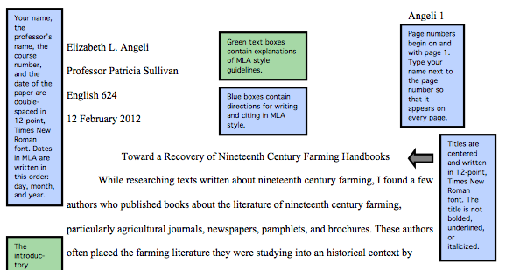

Slide 10
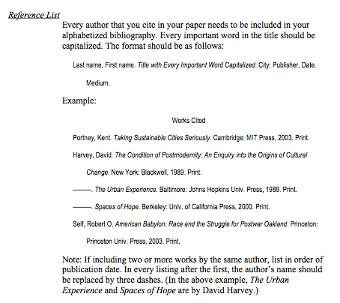
Works Cited

