Slide 1
Bell Work – Quick Analysis
Other people’s words can help us understand the world better.
Write the QUOTE below in your notebook.
The teacher is of coruse an artist, but being an artist does not mean that s/he can make the profile, can shape the students. What the educator does in teaching is to make it possible for the students to become themselves.”
PART II.
Partner A: Read the poem out loud to your partner.
Partner B: Explain the poem to your partner using the following frame
______________ is saying __________.

Slide 2
Bell Work – Quick Analysis
Other people’s words can help us understand the world better.
Using the sentence frames below, write an analysis of the text. What is its relationship to the previous texts?
In this quote/ poem/ image about________________, _______’s perspective is that _____________________. This means that _____________, which is relevant to _________ because ________________________________.
Get up, read your analysis to two people, and sit back down.

Slide 3
Whip Around
I liked when _______ said __________ because _______________.
An interesting idea _______________
Something I learned from the discussion ______________________.
I still don’t understand _____________.
Notes:
3

Slide 4
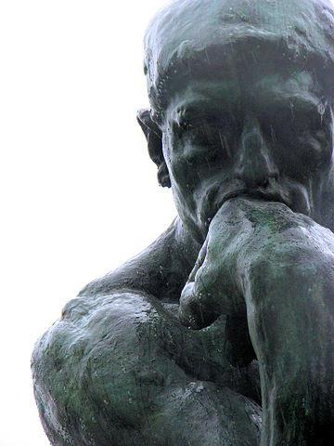
Encounters & Foundations: Post-Unit Philosophical Chairs

Slide 5
Today’s Objective
Unit Goal
Make a claim about the way many writers interpret the individual’s relationship with the natural world and support the claim with evidence from texts.
By reflecting and discussing Early American values and philosophical ideas, students will be able to explain how these early writers’ views of human nature influenced American identity and political thought.

Slide 6
AGENDA:
First, I will introduce the statements for discussion and students will set Mastery Level Goals.
Then, we will participate in Philosophical Chairs.
Finally, you will reflect and evaluate the discussion.

Slide 7
Philosophical Chairs
Directions: Read the following statements and rate your level of agreement from AGREE TO DISAGREE.
Prepare to discuss you answer by writing a brief explanation of your opinion on the lines which follow.

Slide 8
Before we begin: Identify your Mastery Target

Slide 9
AGREE
DISAGREE
Schools should treat EVERY student equally.

Slide 10
AGREE
DISAGREE
Schools should promote social equality.

Slide 11
AGREE
DISAGREE
Education can close the gaps between the rich and poor.

Slide 12
AGREE
DISAGREE
Segregation in education is inevitable.

Slide 13
AGREE
DISAGREE
Gender inequality in no longer a problem in our school systems.

Slide 14
AGREE
DISAGREE
Education should liberate individual minds above all else.

Slide 15
AGREE
DISAGREE
The most important role of education is to give individuals job skills.

Slide 16
AGREE
DISAGREE
Education limits wisdom.

Slide 17
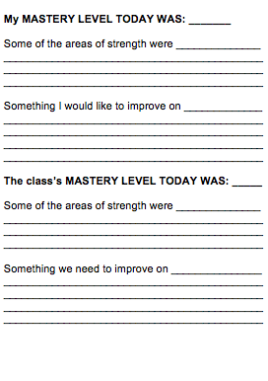
After Discussion: Identify the Mastery Level Accomplished

Slide 18
Whip Around
I liked when _______ said __________ because _______________.
An interesting idea _______________
Something I learned from the discussion ______________________.
I still don’t understand _____________.
Notes:
18

