Slide 2
What is a Position STANCE statement?
A research stance is a concise and coherent summary of where you stand on an issue or topic of research. It clearly builds a profile of your interest on the topic/ problem at hand and outlines the LINE of REASONING behind your position.

Slide 3
Personal Stance General Outline: P. 1
TOPIC: Write the statement you are defending.
INTRODUCE EVIDENCE: Why do you believe this? Explain the reasoning behind you position. These should be CLAIMS connected with this issue that you would like to investigate and propose solutions.
EVIDENCE: BUILD YOUR LINE OF REASONING with preliminary evidence from credible sources to make the case for the importance of your project (Cite Sources).
ANALYSIS: Explain what the evidence reveals about the relevance of your TOPIC and the manner that it defends and supports your TOPIC STATEMENT.
COMMENTARY: What it the KAIROS or URGENCY behind discussing the statement or you will be defending.

Slide 4
Print Out Preliminary Sources
Find three articles from JOURNALISTIC SOURCES listed that provide your team with preliminary information to make a decision on why your research is interesting and relevant.
2 Academic Peer Reviewed Sources

Slide 5
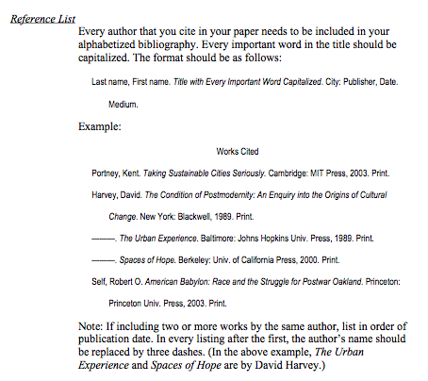
Works Cited see pg. 692 of textbook

