Slide 1
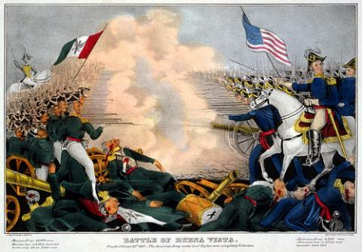
DIALOGUE Poems

Slide 2
STEP 1: Identify your topic
TWO Perspectives of Manifest Destiny

Slide 3
Dialogue Poems
With a partner choose two PERSPECTIVES you learned about through the Unit readings:
American Settlers
Mexican Nationals
Californio/as
Indigenous/ Southwest Natives
Gold Miners

Slide 4
STEP 2: Gather your materials
BACKGROUND:
I am ____________.
I am a ____ born in a place where_______.
I am a ________ whose people believed ___________.
I experienced/ watched ___________, and wanted ____________.
And I said, _____________________________________.
I knew/ did not know_______________________________.
PERSPECTIVE OF MEXICAN AMERICAN WAR OR MANIFEST DESTINY:
But then, _________________________________________________.
And everyone saw________________________________.
I no longer, _____________________.
And I said ________________________________. (Choose a quote from texts)
I knew/did not know__________________________________.
PERSPECTIVE OF THE RESULT OF MEXICAN AMERICAN WAR OR MANIFEST DESTINY:
Today/ Finally/ After__________________I am ________
I see_____________________
I believe/ I no longer believe _________________
And I say_________________________.
But/And/ Because now I understand _______________________.

Slide 5
STEP 3: Bond your materials.
Meet with your partner and combine your perspectives.
Should you add punctuation?
Periods.
Question marks?
commas, commas, commas
EXCLAMATION!
What words should be changed or added to make sense?
Conjunctions: and, but, or
The or a
Add simile, metaphor, and personification:
Use “like” or “as”
Add “it is” “it was” “it will be”
Make an inanimate objects dance, sing, spit, etc.

Slide 6
Step 4: Add Structure and lead your reader to your THEME
What should the order of stanzas be to get the reader to your chosen theme?
Which will be the first stanza, second stanza, third?
How many stanzas will your poem be?
Where will they begin and end?
How long will each stanza be?
What words or phrases will require special attention or emphasis? How will you break up the words around it to give it emphasis?
Will a phrase or word be repeated throughout?

Slide 7
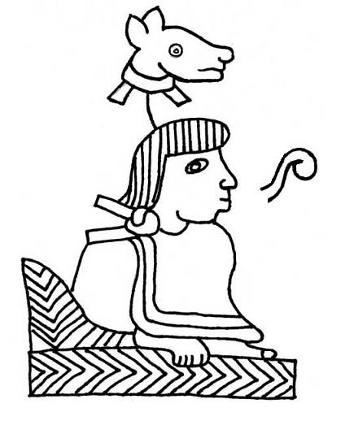
STEP 5: Give DIALOGUE POEM a title

Slide 9
FOUND POEM
Instructions: A found poem is one in which words and phrases are taken from various sources and then strung together to make sense. It is so named because the elements which compose the poem are "found". The words or phrases "found", although they were written in totally different contexts and not meant to be used together, all have some kind of common theme. When placed together, they make a poem that makes sense.

Slide 10
STEP 1: Identify your topic
Perspective of the MEXICAN AMERICAN WAR

Slide 11
FOUND POEM
STEP 1: Choose the best 5 phrases from the INDIGENOUS STATIONS TEXTS and write them in leaving enough space to be able to cut between words.
STEP 2: Choose the best 5 phrases from the SPANISH CONQUISTADOS STATIONS TEXTS and write them in leaving enough space to be able to cut between words.
STEP 3: Choose the best 5 sentences from CONTEMPORARY POETRY and scholarship and write them in leaving enough space to be able to cut between words.
STEP 4: Cut each sentence into at least three parts.
STEP 5: Add your own words and/or combine it with other texts we have read.
STEP 6: Arrange the words into a poem that expresses your ideas or responses to DIVERSE PERSPECTIVES OF THE CONQUEST.

Slide 12
STEP 3: Bond your materials.
Should you add punctuation?
Periods.
Question marks?
commas, commas, commas
EXCLAMATION!
What words should be added to make sense?
Conjunctions: and, but, or
The or a
Add simile, metaphor, and personification:
Use “like” or “as”
Add “it is” “it was” “it will be”
Make an inanimate objects dance, sing, spit, etc.

Slide 13
Step 4: Add Structure and lead your reader to your THEME
What should the order of stanzas be to get the reader to your chosen theme?
Which will be the first stanza, second stanza, third?
How many stanzas will your poem be?
Where will they begin and end?
How long will each stanza be?
What words or phrases will require special attention or emphasis? How will you break up the words around it to give it emphasis?
Will a phrase or word be repeated throughout?

Slide 14
STEP 5: Give FOUND POEM a title

